Slide 1

Neural Networks.
Deep Learning
Kristina Sutiene and Liepa Bikulciene
Kaunas University of Technology Athens, Greece
Nov 18-22, 2024

Slide 2
Outline
Training and Inference
Model performance metrics Key CNN architectures

Slide 3
Table of Contents
Training and Inference
Model performance metrics
Key CNN architectures

Slide 4
Training and Inference
▶ Training is the process through which the model learns from data. During training, a model processes data and incrementally adjusts its parameters to improve its predictions of target outcomes. It involves:
▶ loss functions
▶ optimization methods
▶ backpropagation, and etc.
▶ Inference is the process of using a trained model to make predictions on new, unseen data. Inference is the phase where a model uses its acquired knowledge from training to make predictions or decisions.

Slide 5
Training and Inference. Mechanics of Learning
▶ The learning progress is measured via errors that show how good or bad model is by making predictions over time when parameters are being continuously fine-tuned.
▶ Loss quantifies a model’s error.
▶ A loss function that compares actual and predicted values, which indicates how well the neural network aligns with the training data.
▶ Neural networks are typically trained by methodically minimizing this function, with various types of loss functions available for different applications, for example, cross entropy loss and mean squared error (MSE).

Slide 6
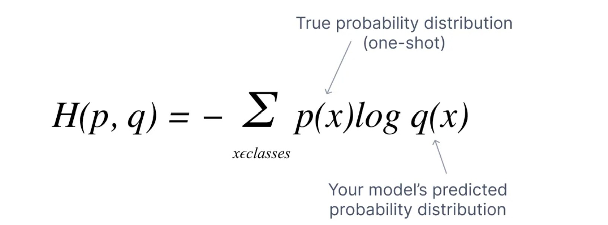
Training and Inference. Mechanics of Learning
▶ Cross entropy loss is often used in classification problems, where it evaluates the predicted probability distribution of a model against the target distribution that we aim for the model to predict.
https://www.v7labs.com/blog/cross-entropy-loss-guide

Slide 7
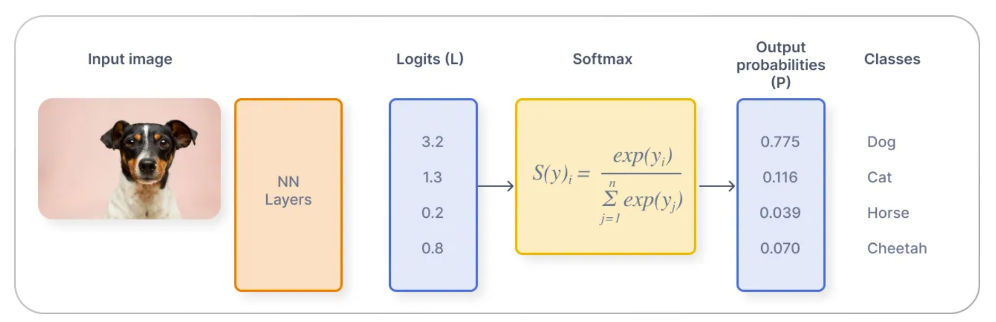
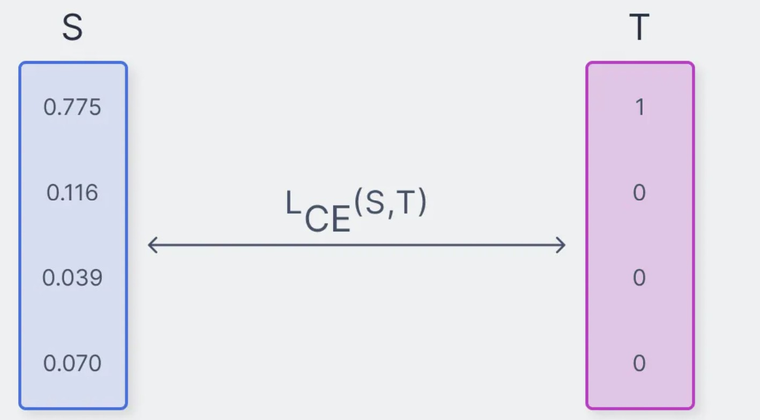
Training and Inference. Mechanics of Learning
Workflow of image classification inference
Softmax transforms logits into probabilities. The cross-entropy function measures the difference between the output probabilities (P) and the actual truth values.
https://www.v7labs.com/blog/cross-entropy-loss-guide

Slide 8
Training and Inference. Mechanics of Learning
▶ Mean squared error (MSE) is one of the most popular loss functions for regression problems.
▶ It quantifies the average of the squared differences between target and predicted values.
n
1
n
X
MSE =
2
(y_{i} − yˆ_{i})
i=1
▶ MSE generates a more larger error as the output prediction becomes increasingly inaccurate. However, a significant drawback of MSE is its sensitivity to outliers. Alternatives like mean absolute error (MAE) and Huber loss offer greater robustness against outliers.

Slide 9
Training and Inference. Mechanics of Learning
▶ Loss is minimized using optimizers - algorithms that adjust a model’s parameters, such as weights and biases, to reduce the loss.
▶ Gradient descent is a foundational optimization algorithm that provides the basis for many advanced optimizers used in deep learning.
▶ The algorithm computes the gradient (the vector of partial derivatives) of the loss function with respect to the model’s parameters. This gradient indicates the direction of the steepest ascent of the loss function.

Slide 10
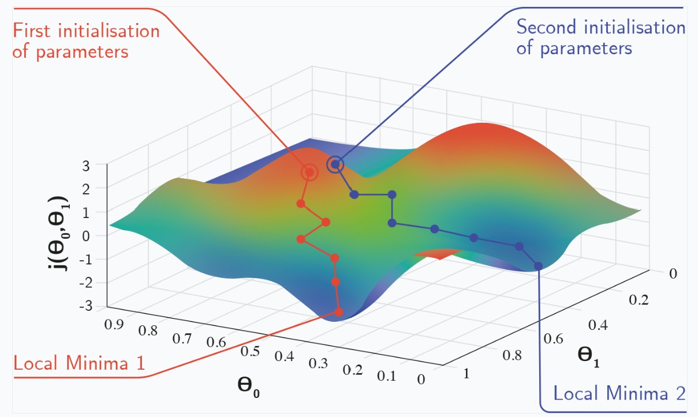
Training and Inference. Mechanics of Learning
Gradient descent may converge to different local minima depending on the initial weight settings.
https://www.aisafetybook.com/textbook/deep-learning

Slide 11
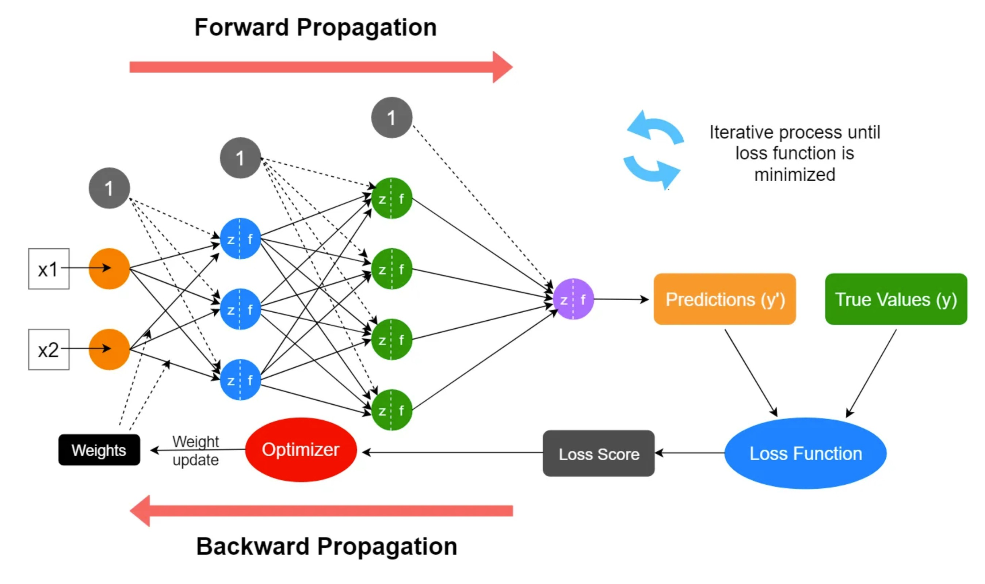
Training and Inference. Mechanics of Learning
https://medium.com/data-science-365/overview-of-a-neural-networks-learning-process-61690a502fa

Slide 12
Training and Inference. Training Methods and Techniques
▶ Various training methods have been developed to tackle common training challenges, with some offering unique learning approaches and others addressing specific computational issues.
▶ These techniques, each with distinct characteristics, can significantly enhance a model’s performance and adaptability and are often combined like ingredients in a recipe.
▶ Let’s consider pre-training and fine-tuning.

Slide 13
Training and Inference. Training Methods and Techniques
Pre-training:
▶ It involves training a model on large datasets to equip it with a variety of generally useful representations for performing specific tasks.
▶ This process provides the model with weights that embody a rich set of learned representations from the beginning, rather than relying on randomly assigned values.
▶ Pre-trained models can either be used directly (referred to as off-the-shelf) or can undergo additional training (called fine-tuning) on a specific task or dataset.
▶ Many CNNs are pre-trained on the ImageNet dataset, enabling them to learn many essential characteristics of the visual world.

Slide 14
Training and Inference. Training Methods and Techniques
Fine-tuning:
▶ This is the process of adjusting a pre-trained model for a new dataset or task through additional training.
▶ The weights from the pre-trained model serve as the initial parameters for the new model.
▶ Some or all layers are then trained on the new task or data, typically using a lower learning rate, while layers that remain untrained are ”frozen” to retain the beneficial representations acquired during pre-training.
▶ Generally, the training occurs in reverse order, starting from the output layer and moving towards the input layer, allowing the more specialized representations of the later layers to adapt to the new task while preserving the broader representations of the earlier layers.

Slide 15
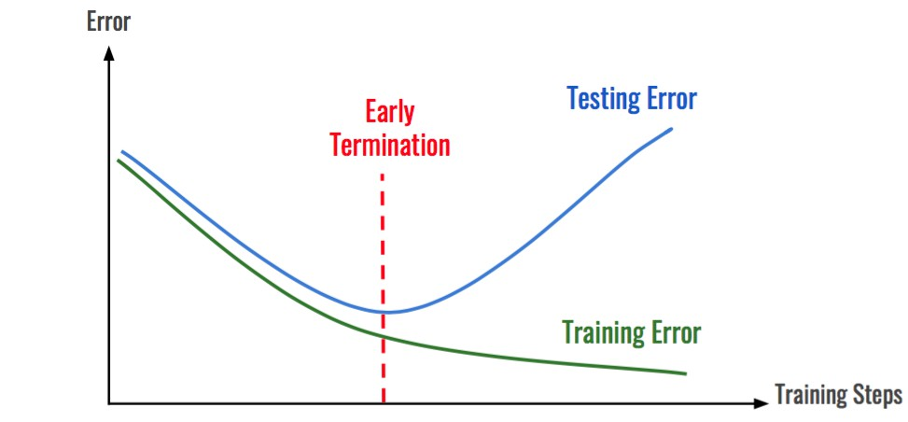
Training and Inference. Overfitting
Overfitting: the model performs exceptionally well on the training data but struggles to generalize to new, unseen data.

Slide 16
Training and Inference. Overfitting
Preventing from overfitting:
▶ Dropout: Dropout randomly drops out neurons from the network during training. This forces the network to learn more robust features that are not dependent on any single neuron.
▶ L1 regularization: L1 regularization regularizes the absolute value of the weights in the network. This can help to reduce the number of weights and make the network more efficient.
▶ L2 regularization: L2 regularization regularizes the square of the weights in the network. This can also help to reduce the number of weights and make the network more efficient.

Slide 17
Table of Contents
Training and Inference
Model performance metrics
Key CNN architectures

Slide 18
Model performance metrics
▶ Performance metrics are essential for assessing the accuracy and reliability of predictions.
▶ The confusion matrix is a valuable evaluation tool that allows professionals to systematically analyze the strengths and weaknesses of their models, by comparing model predictions against the ground truth labels.
▶ The outcomes of binary classification are True Positives, True Negatives, False Positives, and False Negative, which are summarised by a 2 × 2 confusion matrix.

Slide 19
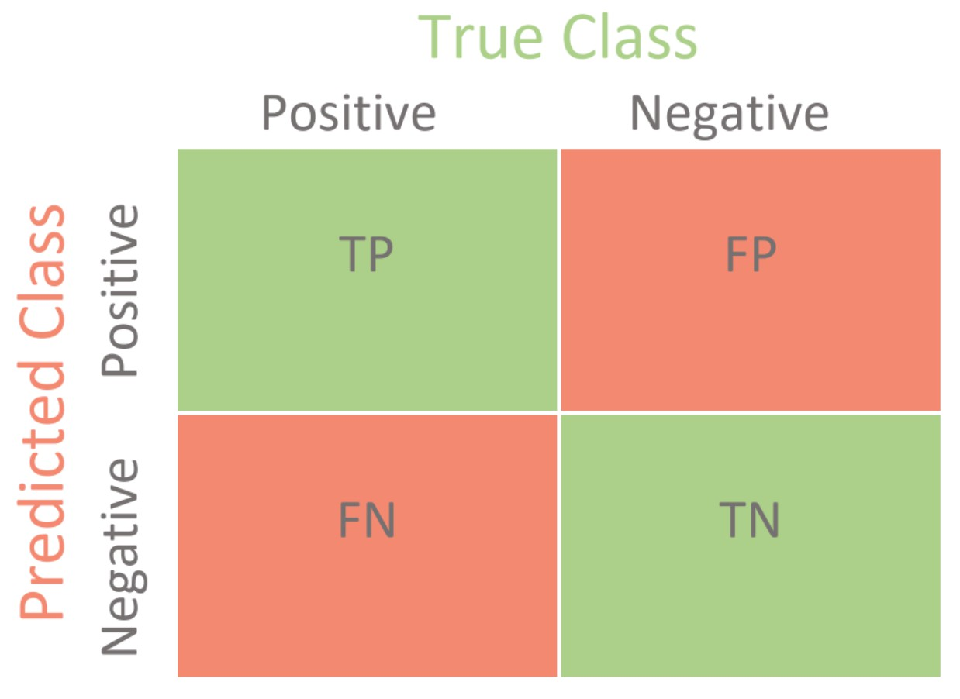
Model performance metrics
https://www.picsellia.com/post/the-confusion-matrix-in-computer-vision

Slide 20
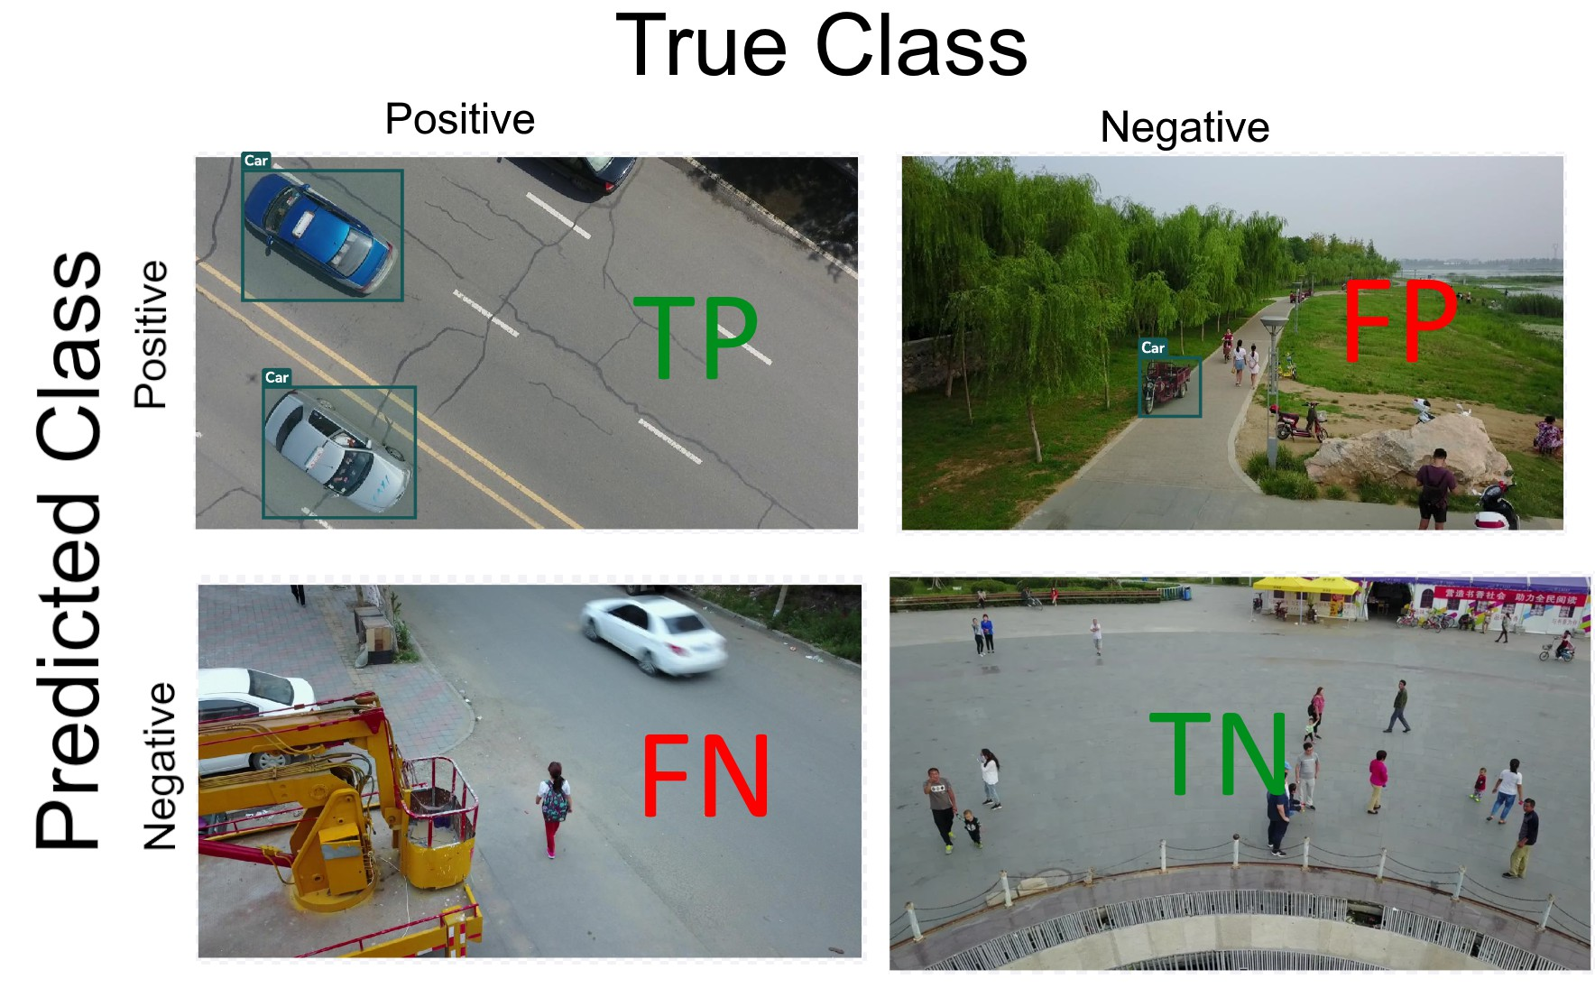
Model performance metrics
Suppose a built model predicts whether the image contains a car or not: two possible outcomes (1-yes, 0-no) are possible.
TP - True Positives, TN - True Negatives, FP - False Positives, and FN - False Negative
https://www.picsellia.com/post/the-confusion-matrix-in-computer-vision

Slide 21
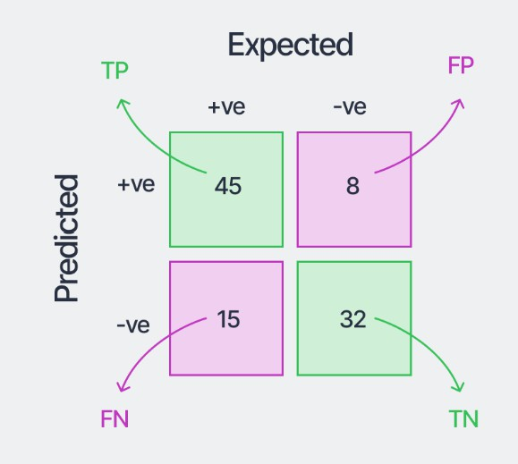
Model performance metrics
https://www.v7labs.com/blog/confusion-matrix-guide

Slide 22
Model performance metrics
Accuracy: the number of samples correctly classified out of all the samples present in the test set
TP + TN
Accuracy =
TP + FP + TN + FN

Slide 23
Model performance metrics
Precision (for the positive class): the number of samples actually belonging to the positive class out of all the samples that were predicted to be of the positive class by the model
TP
Precision =
TP + FP

Slide 24
Model performance metrics
Recall (for the positive class): the number of samples predicted correctly to be belonging to the positive class out of all the samples that actually belong to the positive class.
TP
Recall =
TP + FN

Slide 25
Model performance metrics
Specificity: the number of samples predicted correctly to be in the negative class out of all the samples in the dataset that actually belong to the negative class.
TN
Specificity =
FP + TN

Slide 26
Model performance metrics
F1-Score (for the positive class): the harmonic mean of the precision and recall scores obtained for the positive class.
2 × Precision × Recall
F1-Score =
Precision + Recall

Slide 27
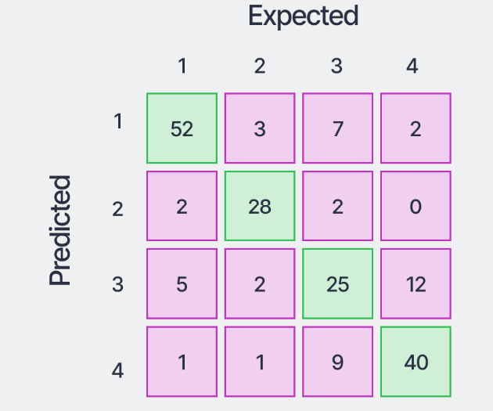
Model performance metrics
Confusion Matrix for Multiple Classes:
https://www.v7labs.com/blog/confusion-matrix-guide

Slide 28
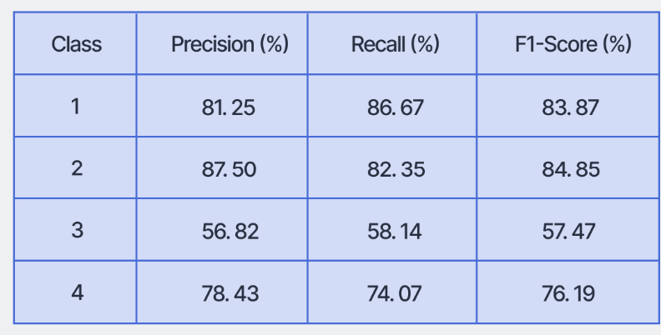
Model performance metrics
Performance metrics for Multiple Classes:

Slide 29
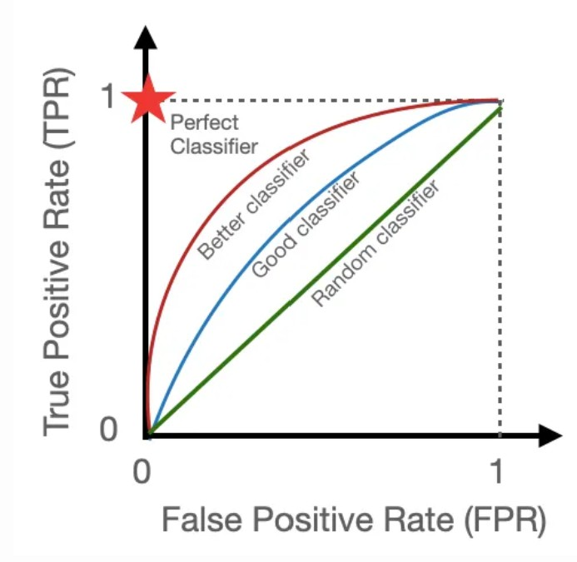
Model performance metrics
Receiver Operating Characteristics (ROC) curve is a graph that plots the ”true positive rate” (TPR=Recall) against the ”false positive rate”
(FPR=1-Specificity) across various threshold settings. It measures the proportion of positive samples in a dataset that the model correctly classifies.
https://www.picsellia.com/post/the-confusion-matrix-in-computer-vision

Slide 30
Model performance metrics
▶ Another key metric for assessing a classifier’s overall performance is the ”Area Under the ROC Curve” (AUROC or AUC).
▶ This metric represents the area beneath the ROC curve; a higher AUC indicates a stronger classifier.
▶ For example, an AUC of 90% reflects solid performance, while a model with no predictive skill has an AUC of 50%, and a perfect model achieves an AUC of 100%.

Slide 31
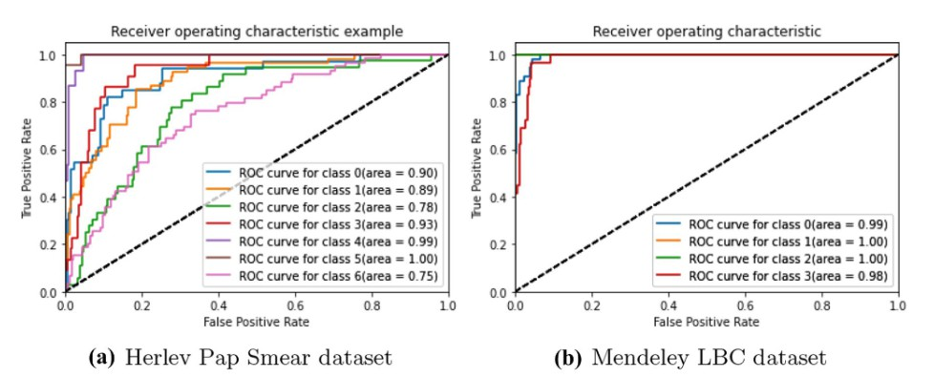
Model performance metrics
The closer a learner’s ROC curve is to the point (0.0, 1.0) — which represents an ideal model—the better its predictive performance across all thresholds.
https://www.v7labs.com/blog/confusion-matrix-guide

Slide 32
Table of Contents
Training and Inference
Model performance metrics
Key CNN architectures

Slide 33
Key CNN architectures. LeNet
▶ LeNet, as a pioneering architecture, was introduced by LeCun et al, in 1998.
▶ Widely known for handwritten digit recognition (in bank cheques).
▶ LeNet has 2 convolutional and 3 full layers, and around 60,000 parameters.
▶ tanh activation function was mainly used.
▶ However, due to computational constraints, CNNs did not rise in popularity for over a decade.
Y.Lecun,L.Bottou,Y.BengioandP.Haffner,Gradient-basedlearningappliedtodocumentrecognition,inProceedingsoftheIEEE,vol.
86,no.11,pp.2278-2324,1998

Slide 34
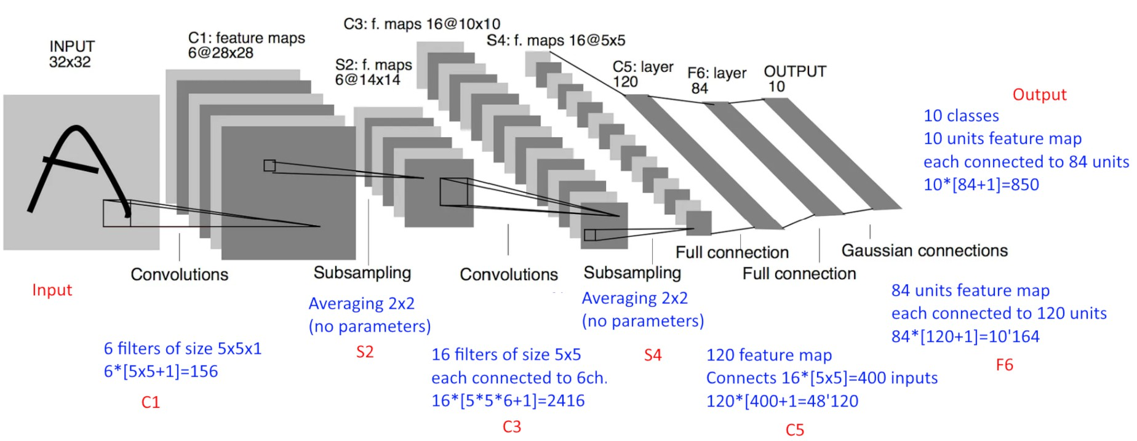
Key CNN architectures. LeNet
156+0+2’416+0+48’120+10’164+850=61’706

Slide 35
Key CNN architectures. AlexNet
▶ AlexNet is a classic convolutional neural network architecture, proposed by Alex Krizhevsky, et al.
▶ AlexNet was among the earliest deep CNNs to achieve substantial accuracy in the 2012 ImageNet LSVRC-2012 challenge, reaching 84.7% accuracy (2nd place : 73.8%).
▶ AlexNet is an example of a Deep neural network, as it includes 60 million parameters.
▶ Dropout feature was introduced to ensure overfitting is avoided.
▶ Data Augmentation (mirroring and cropping the images to increase the variation) was also introduced.
Krizhevsky,Alex;Sutskever,Ilya;Hinton,GeoffreyE.ImageNetclassificationwithdeepconvolutionalneuralnetworks".
CommunicationsoftheACM.60(6):8490,2012

Slide 36
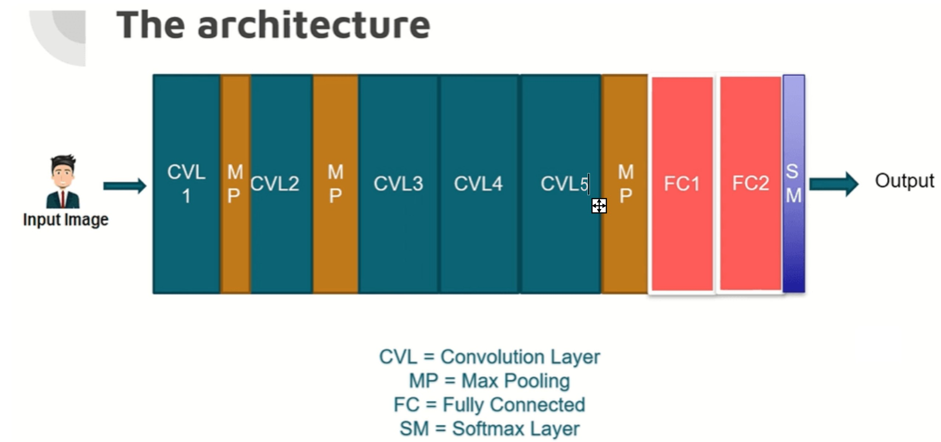
Key CNN architectures. AlexNet
▶ AlexNet has total 8 layers, 5 convolutional and 3 fully connected layers.
▶ The sizes of the convolutional filters are 11×11, 5×5, 3×3, 3×3, and 3×3 for the respective convolutional layers
▶ The activation used is the Rectified Linear Unit (ReLU).
https://www.nomidl.com/deep-learning/introduction-to-alexnet-architecture/

Slide 37
Key CNN architectures. GoogleNet (Inception v1)
▶ GoogleNet achieved a breakthrough result by lowering the top-5 error rate to below 7% in the ILSVRC 2014 challenge.
▶ The inception module was introduced by a team of Google researchers solved this problem creatively. Instead of deciding what filter size (3×3, 5×5, or 1×1) to use and when to perform a max pooling operation, they combined multiple convolution filters, without exploding computations.
▶ Compared to AlexNet, GoogleNet has fewer parameters, with a ratio of 10:1 (roughly 6 million instead of 60 million)

Slide 38
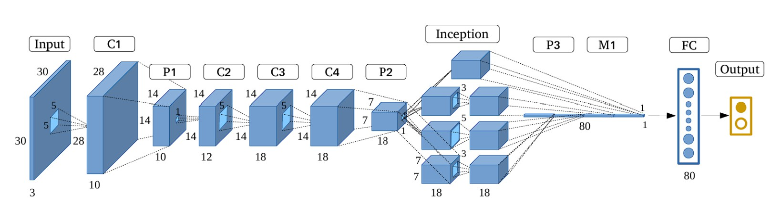
Key CNN architectures. GoogleNet (Inception v1)
The key features of GoogLeNet:
▶ Inception Module, the 1×1 Convolution, Global Average Pooling, and Auxiliary Classifiers for Training
https://pubmed.ncbi.nlm.nih.gov/29084154/

Slide 39
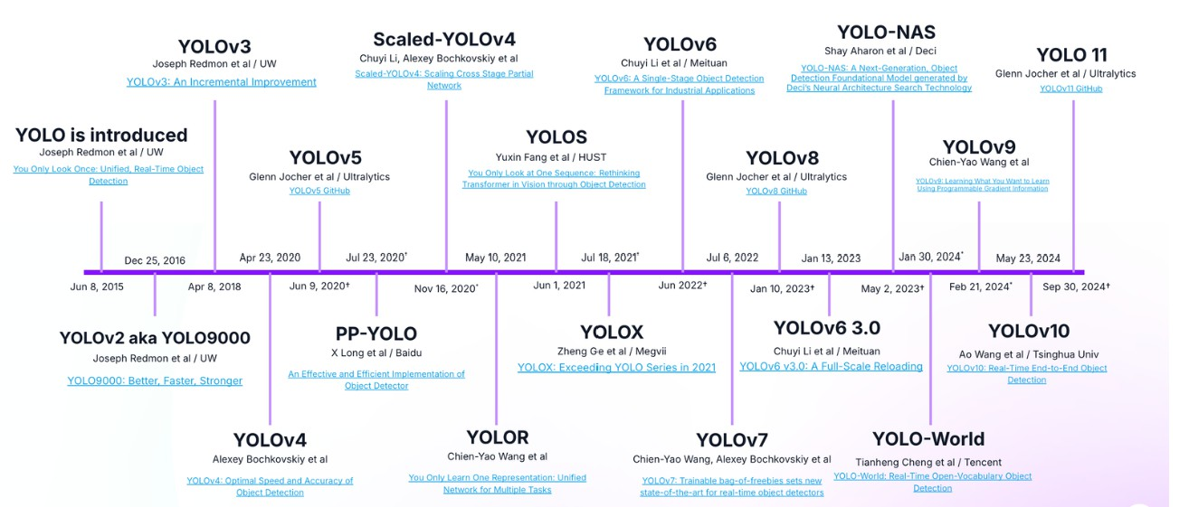
Key CNN architectures. YOLO
▶ You Only Look Once (YOLO) is a state-of-the-art, a real-time object detection algorithm, leading the competitions due to its speed, detection accuracy, good generalization, and open-source
▶ It was first introduced by Joseph Redmon et al. in 2016. .
https://arxiv.org/abs/1506.02640
https://blog.roboflow.com/guide-to-yolo-models/
39 / 43

Slide 40
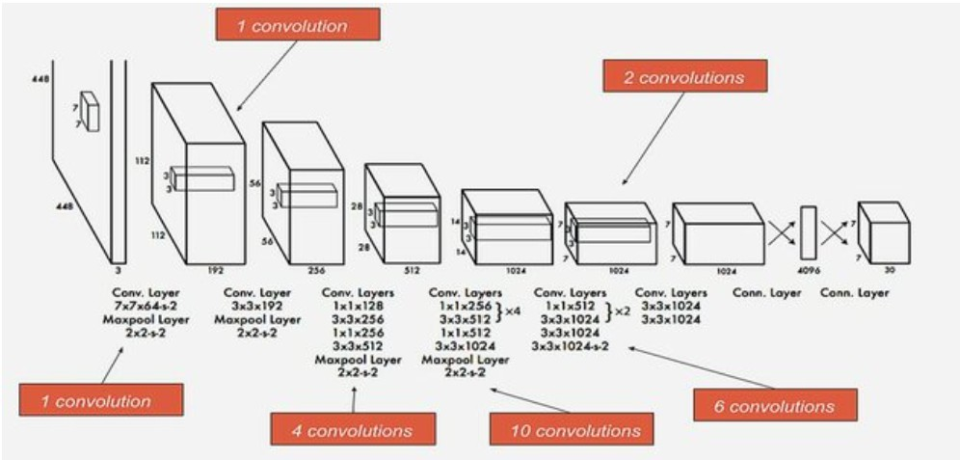
Key CNN architectures. YOLO
YOLO architecture (originally published) is similar to GoogleNet: 24 convolutional layers, 4 max-pooling layers, and 2 fully connected layers.
www.researchgate.net/publication/371136193_Real-time_Object_Detection_YOLOv1_Re-Implementation_in_PyTorch/
40 / 43

Slide 41
Key CNN architectures. YOLO. Key Components
▶ YOLO uses a single CNN to predict bounding boxes and class probabilities directly from full images in one evaluation.
▶ Grid Division: The input image is divided into an S×S grid. Each grid cell is responsible for predicting bounding boxes and their corresponding class probabilities for objects whose center falls within that cell.
▶ Bounding Box Prediction: Each grid cell predicts a fixed number of bounding boxes (usually 2) along with their confidence scores. The confidence score reflects how confident the model is that the box contains an object and also how accurate the box is.
▶ Class Probability Prediction: Each grid cell also predicts class probabilities for the objects. These probabilities indicate the likelihood of each class being present within the bounding box.
▶ The final output of the model consists of a tensor that includes the bounding box coordinates, confidence scores (=P(object)×IOU), and class probabilities.
41 / 43

Slide 42
References
▶ https://www.geeksforgeeks.org/introduction-convolution-neural-network/
▶ https://www.aisafetybook.com/textbook/deep-learning/
▶ https://www.geeksforgeeks.org/deep-learning-tutorial/
▶ http://neuralnetworksanddeeplearning.com/
▶ https://www.saedsayad.com/artificial_neural_network_bkp.htm
▶ https://muneebsa.medium.com/deep-learning-101-lesson-18-image-data-in-machine-vision-d2e07afa1c36
▶ https://www.v7labs.com/blog/image-annotation-guide
▶ https://www.cloudfactory.com/image-annotation-guide
▶ https://www.v7labs.com/blog/cross-entropy-loss-guide
▶ https://www.v7labs.com/blog/confusion-matrix-guide
▶ https://www.geeksforgeeks.org/convolutional-neural-network-cnn-architectures/
▶ https://towardsdatascience.com/convolutional-neural-networks-explained-9cc5188c4939

Slide 43
Neural Networks.
Deep Learning
Kristina Sutiene and Liepa Bikulciene
Kaunas University of Technology Athens, Greece
Nov 18-22, 2024

