Slide 1

Neural Networks.
Deep Learning
Kristina Sutiene and Liepa Bikulciene
Kaunas University of Technology Athens, Greece
Nov 18-22, 2024

Slide 2
Outline
AI Taxonomy
Computer Vision Deep Learning
Deep Learning. Model Building Blocks Image Data
Artificial Neural Network Key Activation Functions Residual Connections Convolution
Many hidden layers

Slide 3
Table of Contents
AI Taxonomy
Computer Vision Deep Learning
Deep Learning. Model Building Blocks Image Data
Artificial Neural Network Key Activation Functions Residual Connections Convolution
Many hidden layers

Slide 4
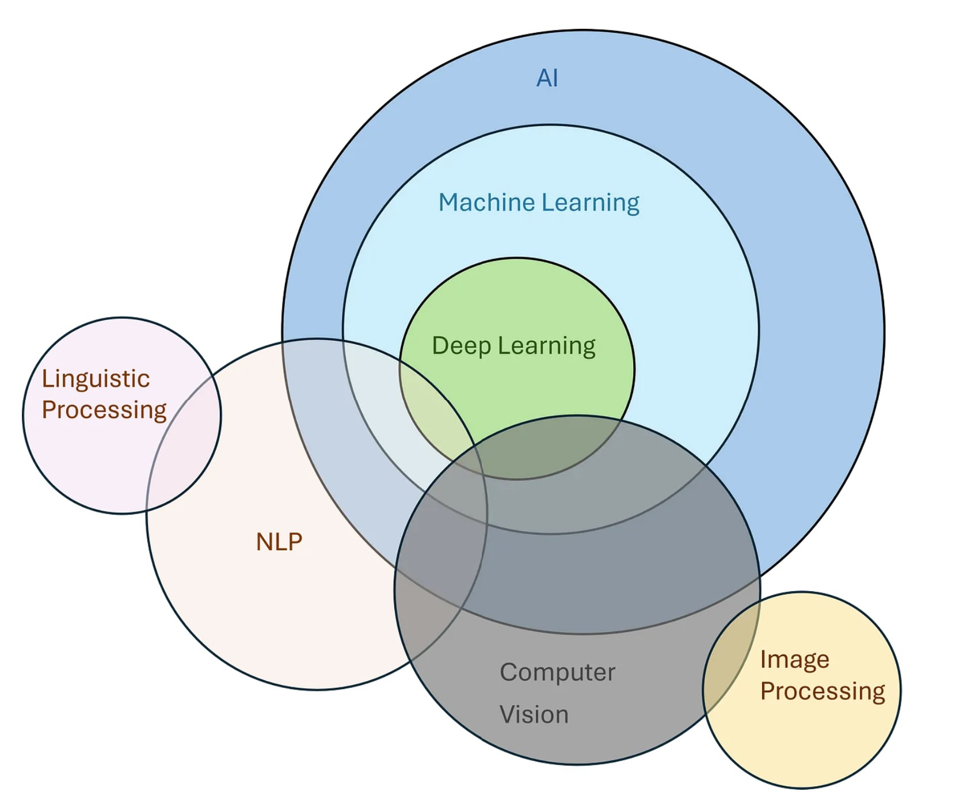
AI Taxonomy
https://medium.com/@jainpalak9509/breakdown-simplify-ai-ml-nlp-deep-learning-computer-vision-c76cd982f1e4

Slide 5
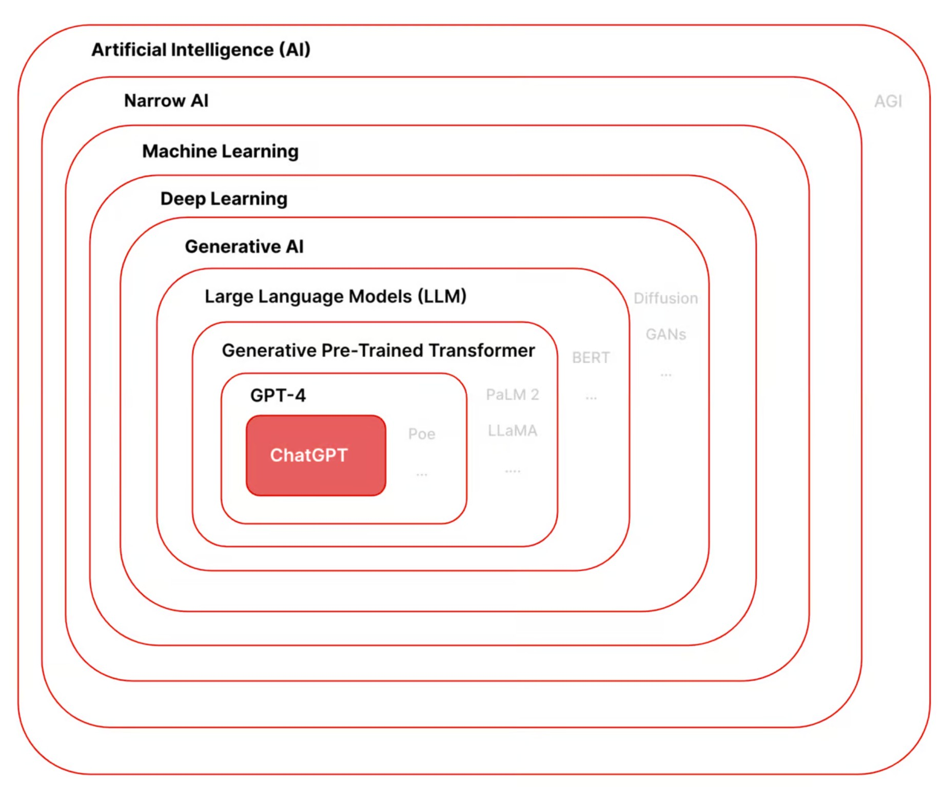
AI Taxonomy
https://www.gptechblog.com/5-diagrams-to-help-you-understand-generative-ai/

Slide 6
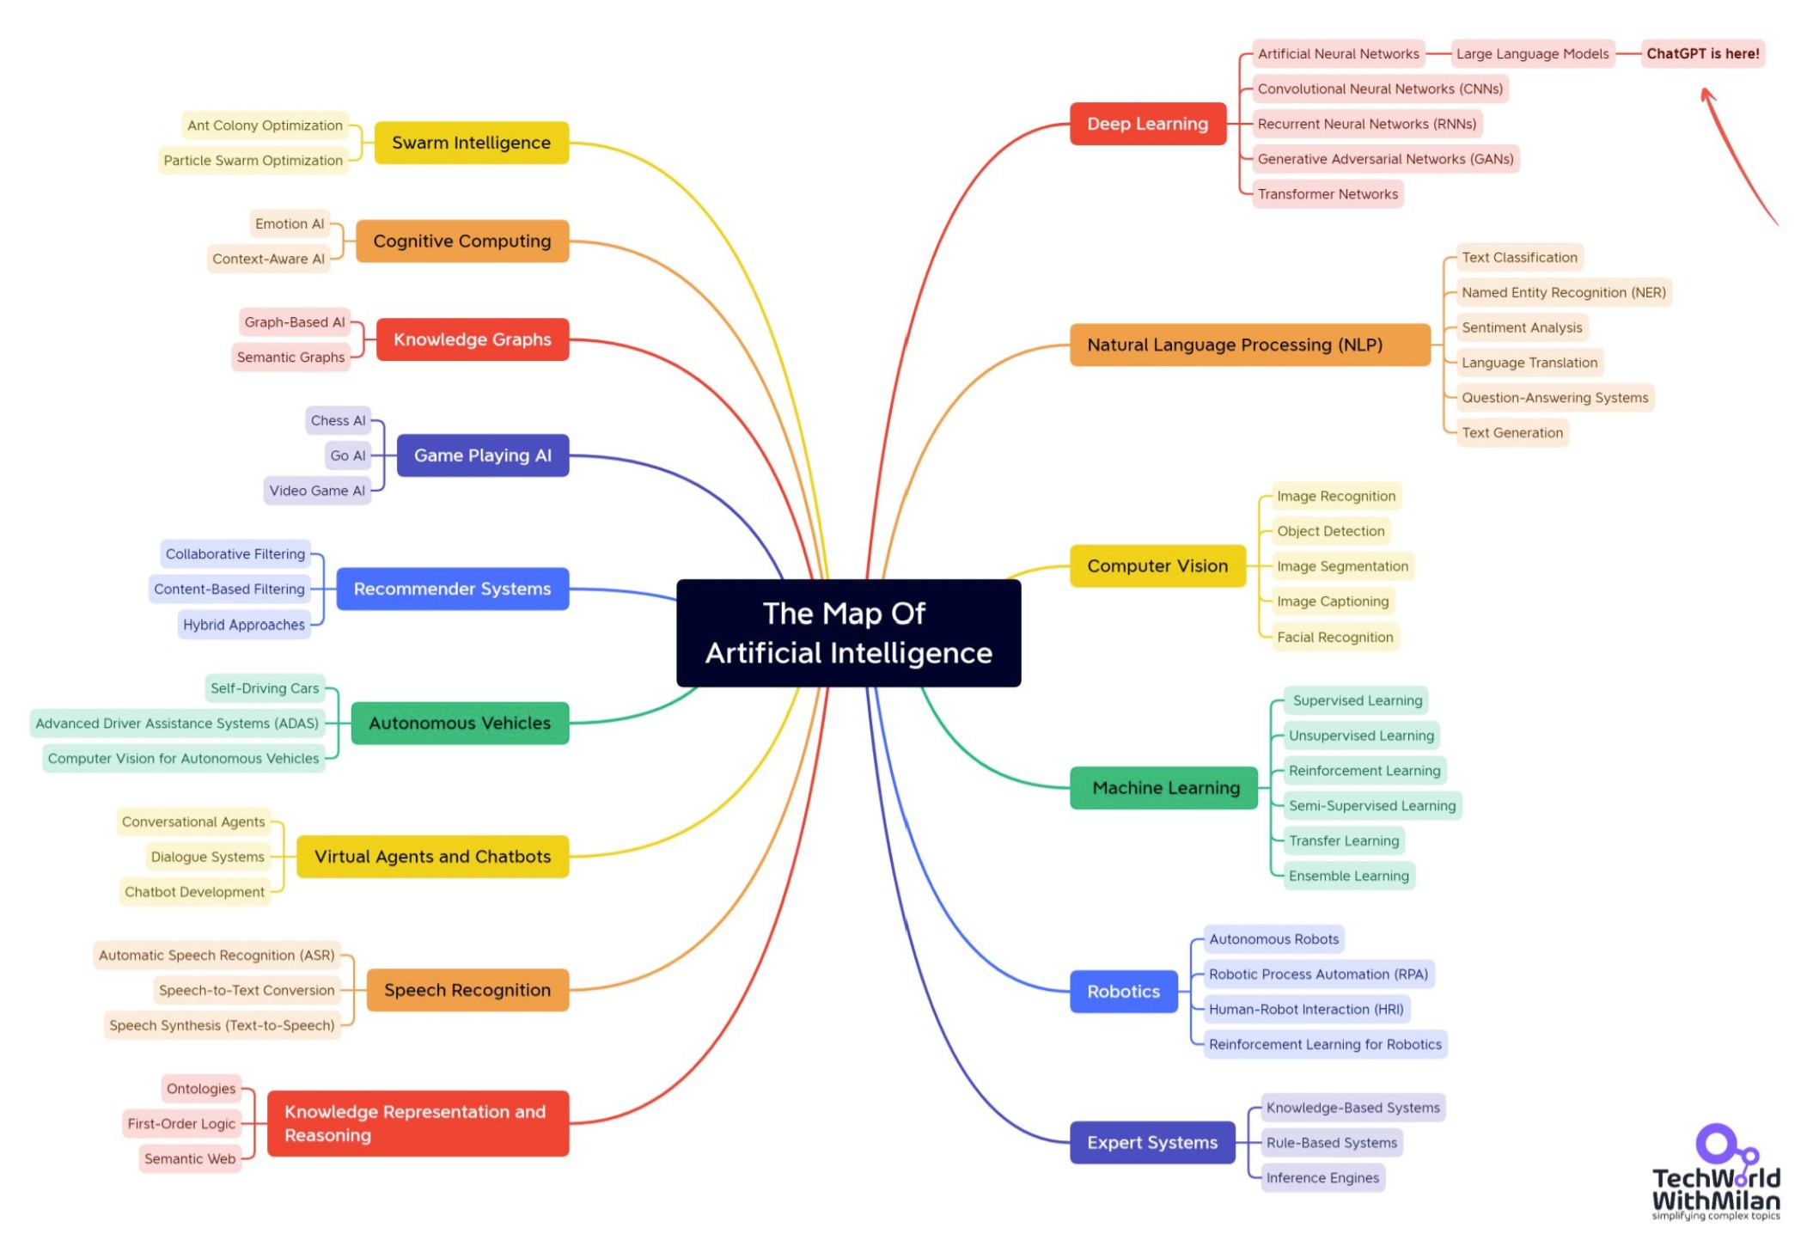
AI Taxonomy
https://www.gptechblog.com/5-diagrams-to-help-you-understand-generative-ai/

Slide 7
Table of Contents
AI Taxonomy
Computer Vision
Deep Learning
Deep Learning. Model Building Blocks Image Data
Artificial Neural Network Key Activation Functions Residual Connections Convolution
Many hidden layers

Slide 8
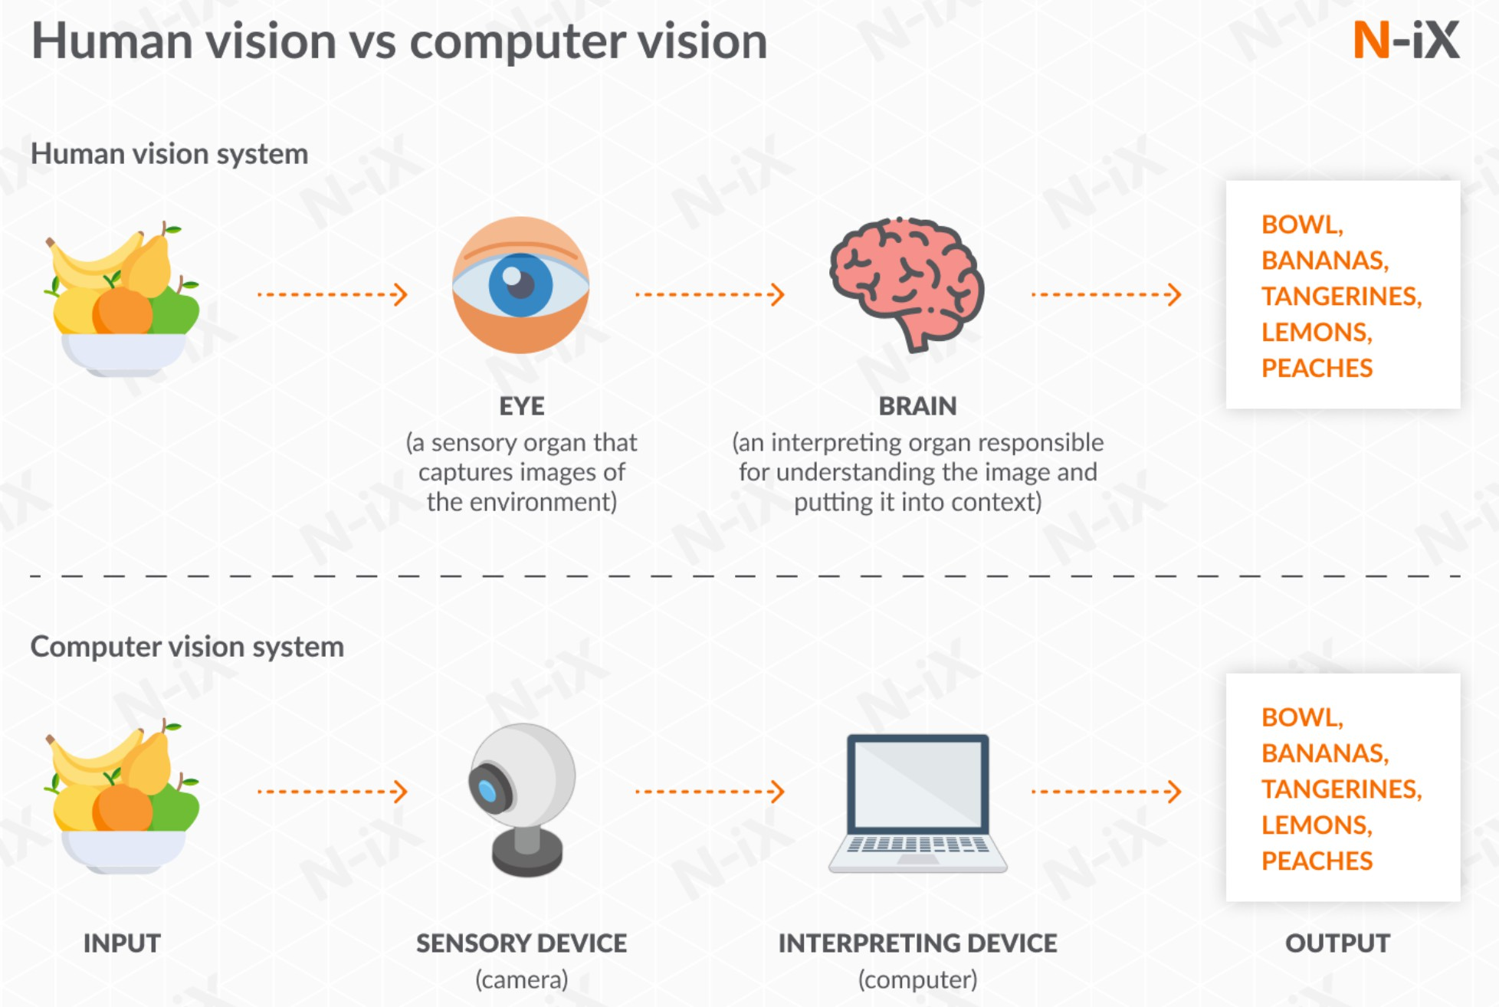
Computer Vision
https://www.n-ix.com/computer-vision/

Slide 9
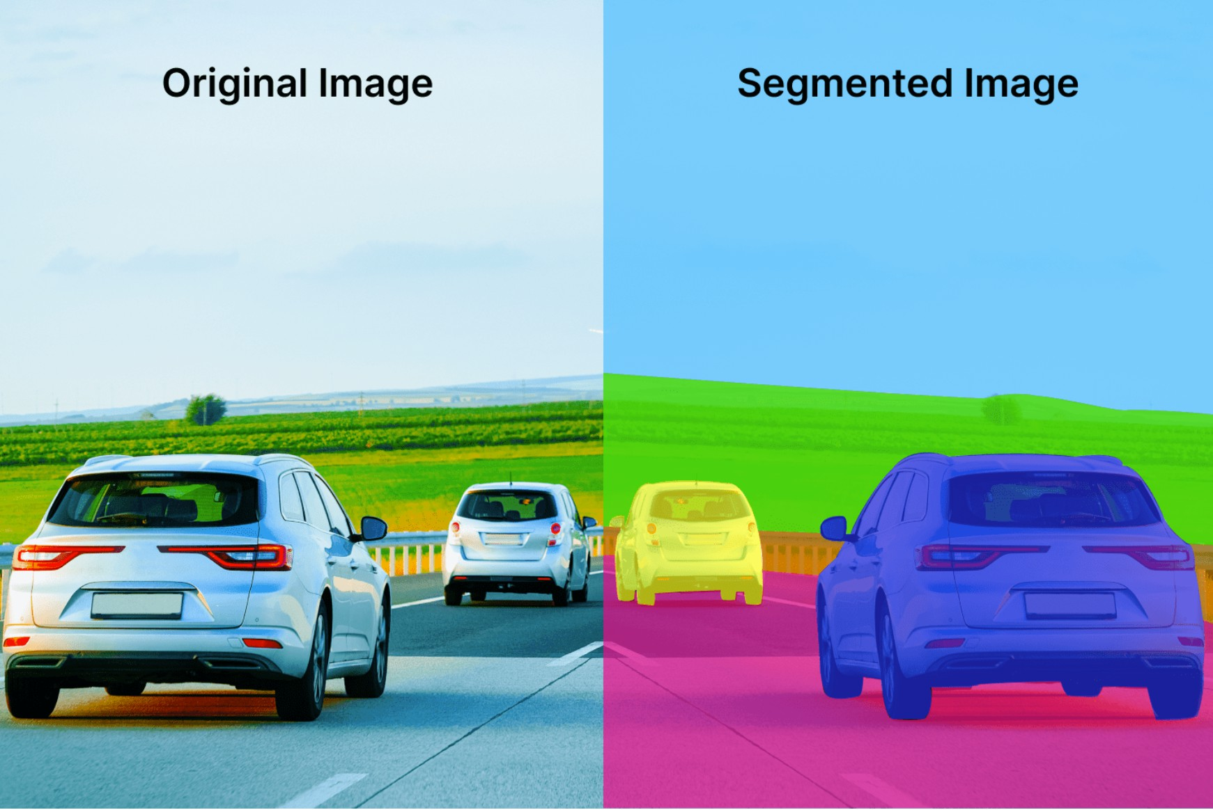
Computer Vision. Types
Image segmentation divides an image into multiple segments, or regions, to make it easier to analyze and interpret. This technique assigns a label to each pixel in the image, delineating exact boundaries of objects or regions of interest.
Common Models: U-Net and Mask R-CNN are popular models in this field.
https://deeplobe.ai/image-segmentation-the-most-interesting-applications/

Slide 10
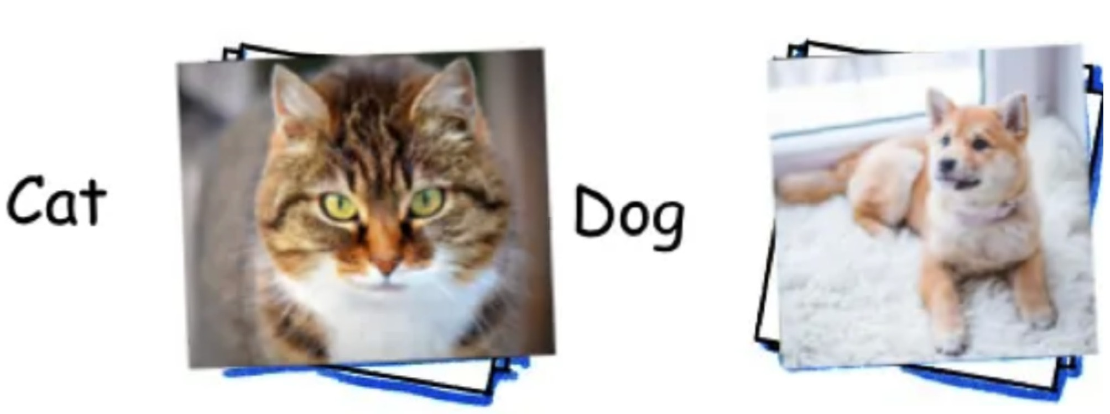
Computer Vision. Types
Image classification is a computer vision task focused on identifying what category or class an object belongs to in an image by assigning a single label from a set of predefined categories (e.g., ”cat,” ”dog,” ”car”) to the entire image or a detected region of interest.
Common Models: Convolutional Neural Networks (CNNs) like AlexNet, VGG, and ResNet because they excel at learning spatial hierarchies of features.
https://towardsdatascience.com/
10-papers-you-should-read-to-understand-image-classification-in-the-deep-learning-era-4b9d792f45a7

Slide 11
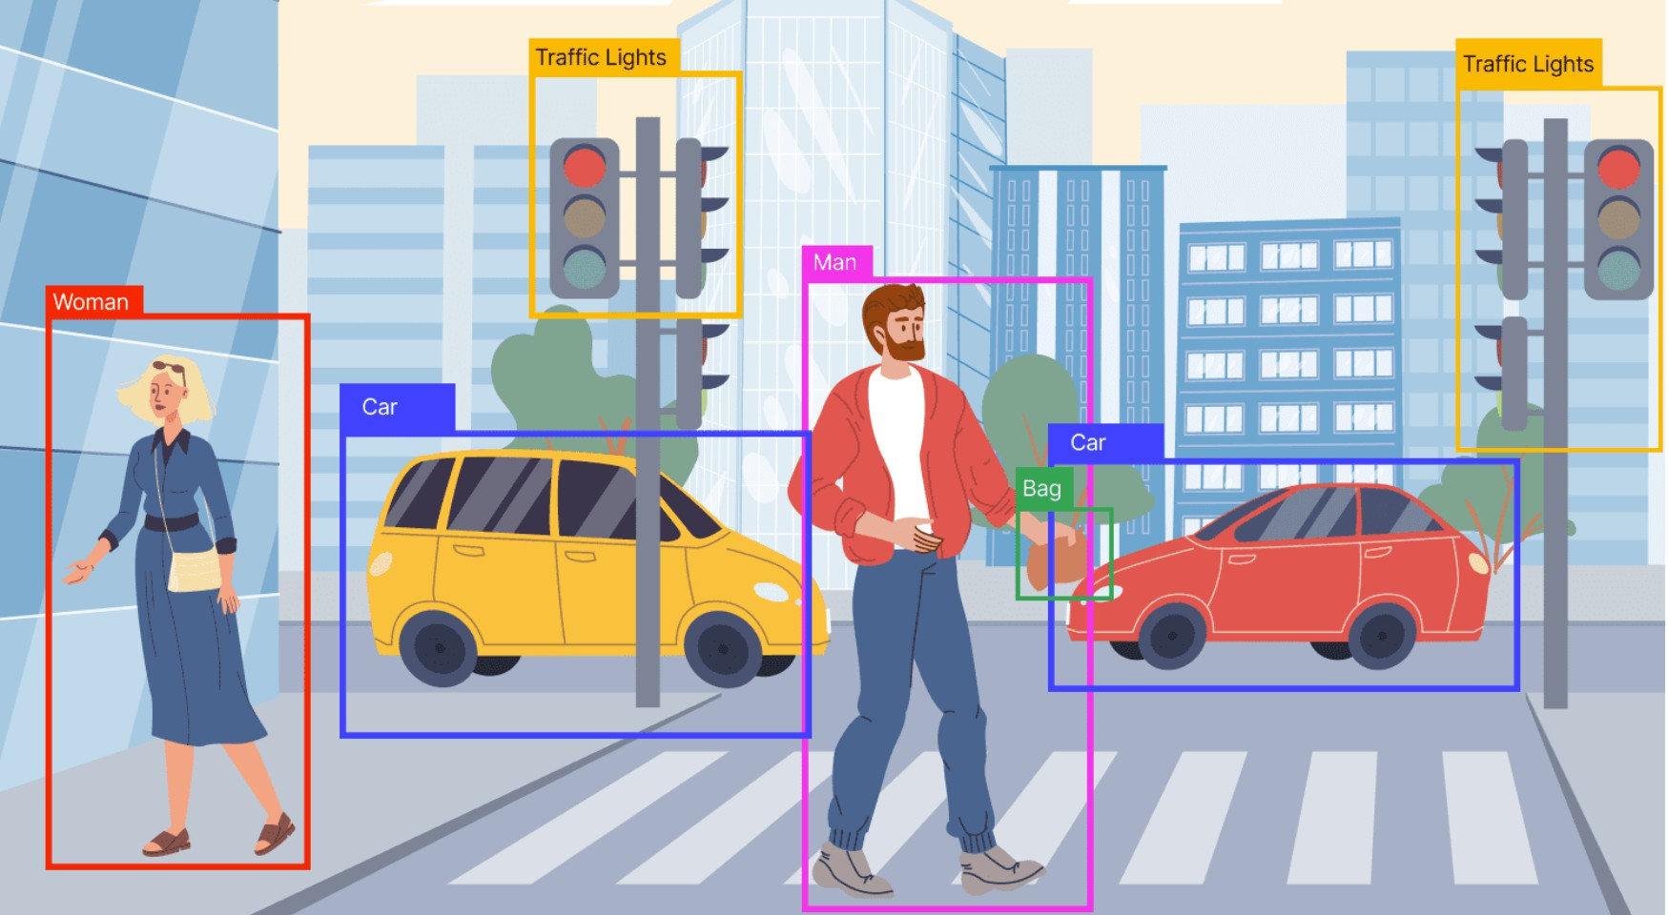
Computer Vision. Types
Object detection identifies multiple objects within the same image, labels them, and determines their positions by marking them with bounding boxes.
Classification: Identifying and labeling objects within the image
Localization: Specifying the exact locations of each object, typically by drawing bounding boxes around them.
Deep learning models such as YOLO (You Only Look Once), SSD (Single Shot MultiBox Detector), and Faster R-CNN are used for their speed and accuracy.
https://deeplobe.ai/exploring-object-detection-applications-and-benefits/

Slide 12
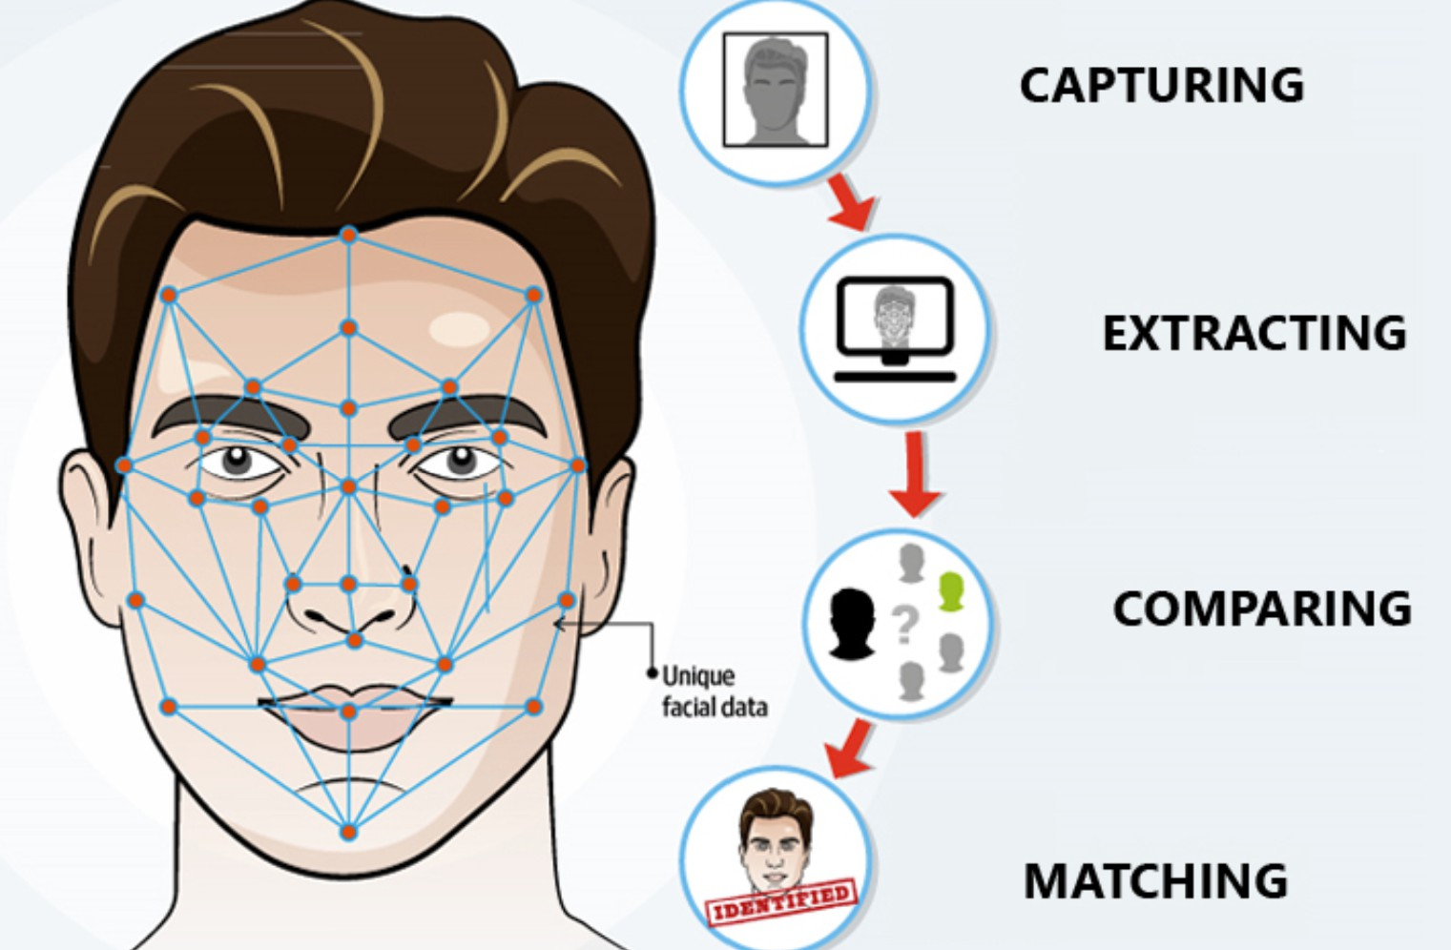
Computer Vision. Types
Facial recognition used to identify or verify a person by analyzing and comparing patterns in facial features from an image or video: locating the presence of a face; feature extraction (eye distance, nose shape, etc); matching these features against a database of stored facial images to find the best match.
CNN architectures like FaceNet or VGGFace are trained to recognize faces.
https://www.starlinkindia.com/blog/biometrics-face-recognition/
12 / 64

Slide 13
Computer Vision. Types
Among many others, we could also mention these:
Edge detection: This method identifies the outer edges of objects to identify what the image consists of.
Pattern detection: This technique helps with identification of colors, shapes, and other visual elements in images.
Feature matching: This method helps match similarities in images to classify them.
While basic computer vision applications might rely on a single technique, more advanced ones, such as self-driving cars, often require a combination of multiple computer vision methods.
https://www.digitaldividedata.com/blog/everything-about-computer-vision

Slide 14
Table of Contents
AI Taxonomy
Computer Vision Deep Learning
Deep Learning. Model Building Blocks Image Data
Artificial Neural Network Key Activation Functions Residual Connections Convolution
Many hidden layers

Slide 15
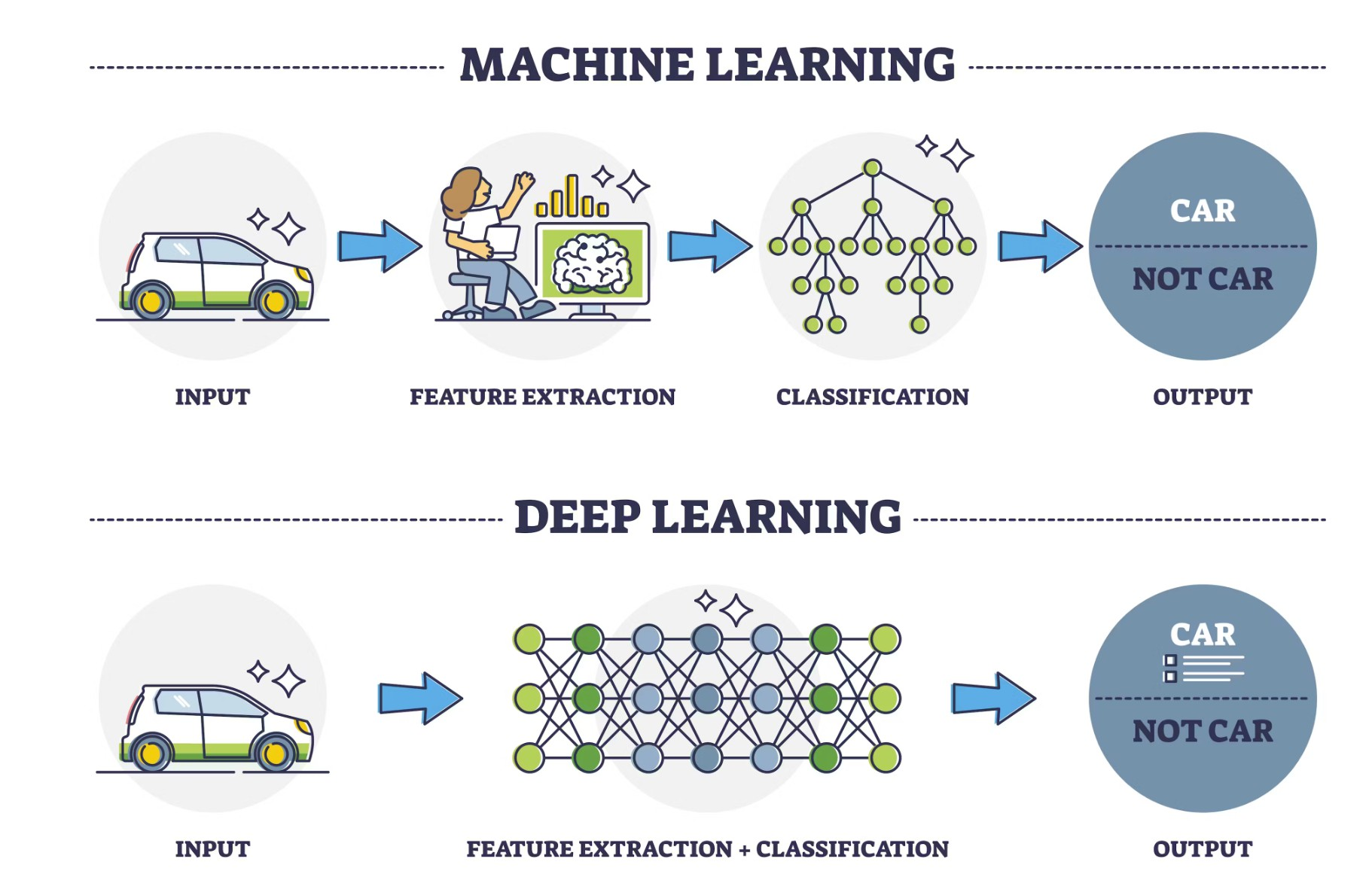
Deep Learning
Deep learning is a subset of machine learning that employs artificial neural networks with many layers (”deep” neural networks) to analyze complex data.
https://www.turing.com/kb/ultimate-battle-between-deep-learning-and-machine-learning

Slide 16
Deep Learning. Key Aspects
Neural Networks: Inspired by the structure of the human brain, these are made up of interconnected layers of nodes, or ”neurons.”
Training with Large Datasets: Deep learning requires significant amounts of labeled data for training, especially in supervised learning setups.
Layered Representation Learning: The model learns representations in a hierarchical manner, with each layer capturing increasingly complex patterns.
Optimization Algorithms: Techniques such as backpropagation adjust the model’s parameters by minimizing the error, allowing the network to learn over time.
High Computational Power: Deep learning typically requires high processing power to handle complex calculations and massive datasets.

Slide 17
Deep Learning. Applications
Computer Vision: Image classification, object detection, facial recognition, image segmention, etc.
Natural Language Processing (NLP): Language translation, sentiment analysis, and chatbots, etc.
Speech Recognition: Converting spoken words into text, used in virtual assistants like Siri and Alexa
and many other tasks, for instance, product recommendation, energy load prediction in a power grid, artwork creation, etc. applications.
Deep learning models capture complex relationships within data. Generally, machine learning models are designed to transform any input into a meaningful output. Deep learning models are a particularly valuable type of machine learning model capable of representing a wide range of connections between inputs and outputs.

Slide 18
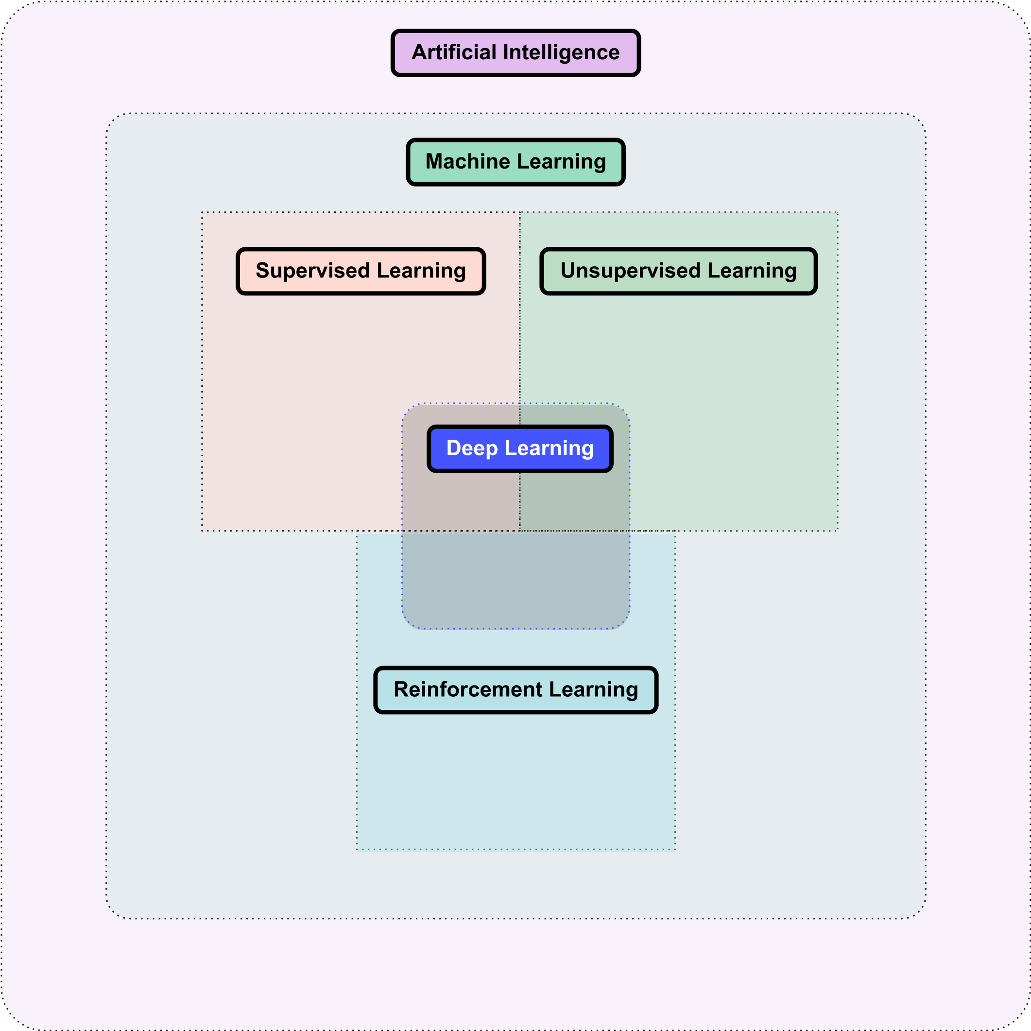
Deep Learning. Types of Learning
https://www.aisafetybook.com/textbook/deep-learning

Slide 19
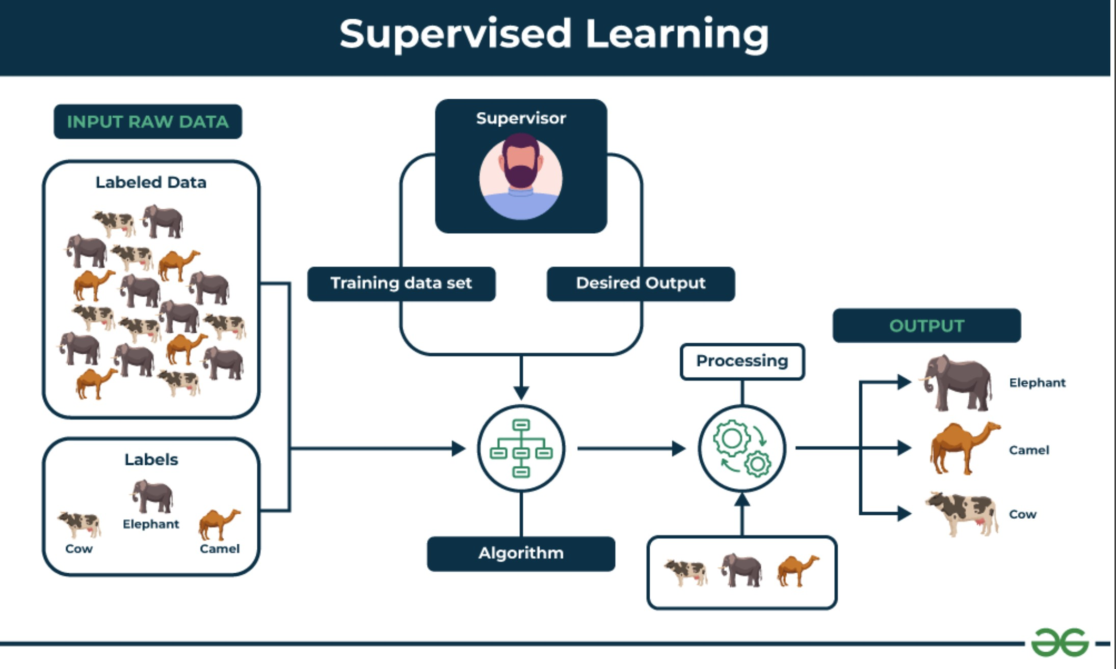
Deep Learning. Supervised Learning
Supervised learning involves training a machine from labeled data.
Labeled data consists of examples with the correct answer or classification.
Machine learns the relationship between inputs (images) and outputs (image labels).
▶ The trained machine can then make predictions on new, unlabeled data.
https://www.geeksforgeeks.org/supervised-unsupervised-learning/

Slide 20
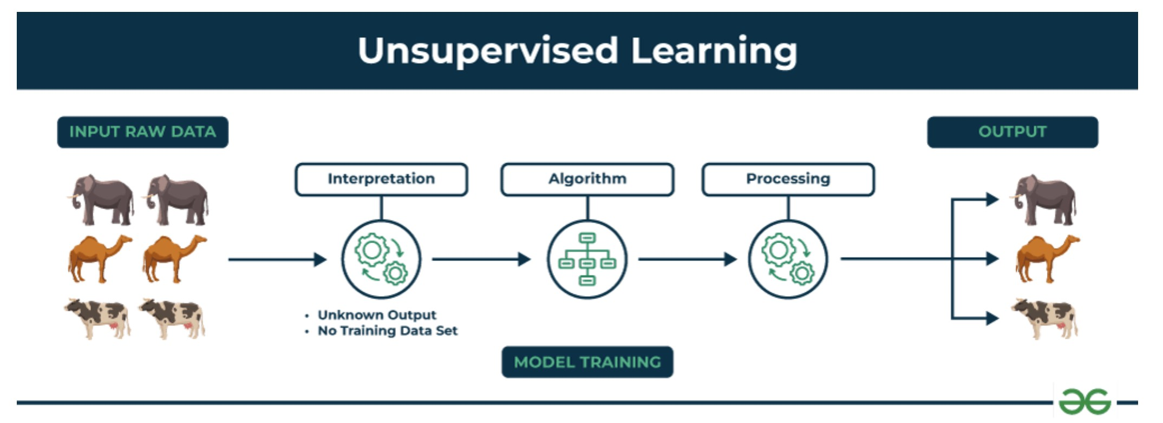
Deep Learning. Unsupervised Learning
Unsupervised learning allows the model to discover patterns and relationships in unlabeled data
Clustering algorithms group similar data points together (clusters) based on their inherent characteristics
The machine learns the relationship between inputs (images) and outputs (image labels).
Feature extraction captures essential information from the data, enabling the model to make meaningful distinctions.
Obtained clusters could be understood as categories (labels) identified by machine based on the extracted patterns and characteristics.
https://www.geeksforgeeks.org/supervised-unsupervised-learning/

Slide 21
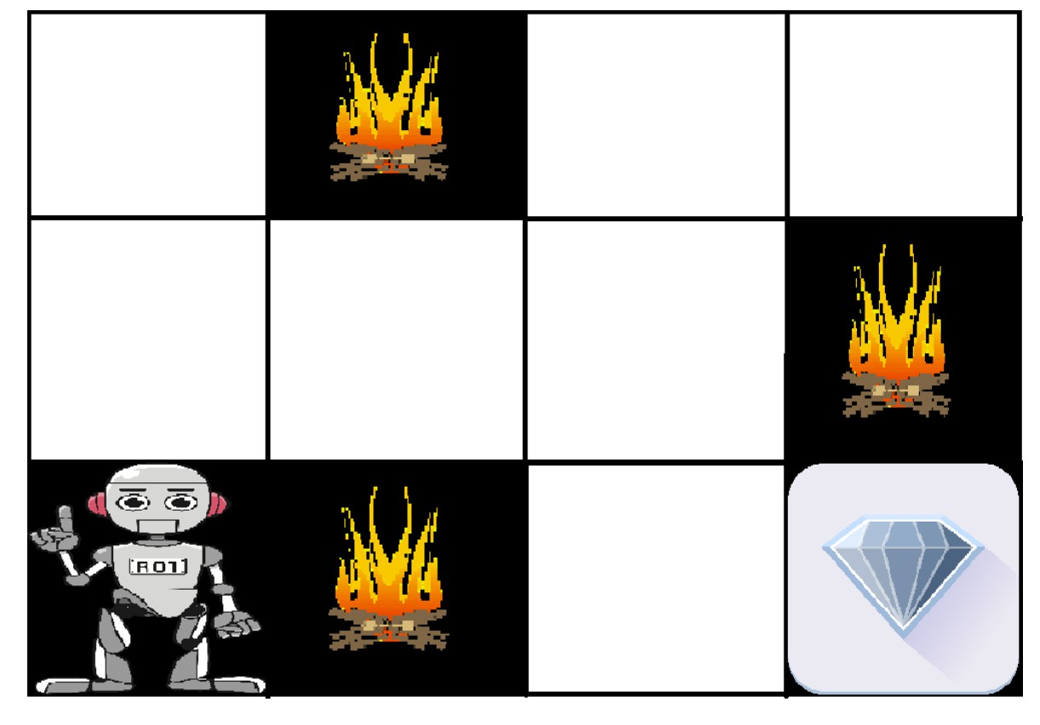
Deep Learning. Reinforcement Learning
It is learning through experience
Agent learns to achieve a goal in an uncertain, potentially complex environment by performing actions and receiving feedback through rewards or penalties
It operates on the principle of learning optimal behavior through trial and error.
Figure: Agent, Environment, State, Action, Reward

Slide 22
Table of Contents
AI Taxonomy
Computer Vision Deep Learning
Deep Learning. Model Building Blocks Image Data
Artificial Neural Network Key Activation Functions Residual Connections Convolution
Many hidden layers

Slide 23
Table of Contents
AI Taxonomy
Computer Vision Deep Learning
Deep Learning. Model Building Blocks Image Data
Artificial Neural Network Key Activation Functions Residual Connections Convolution
Many hidden layers

Slide 24
Image Data
Photo/Video −→ Digital Image −→ Matrix of pixels: (rows x columns) −→
Each pixel holds a value corresponding to its intensity
In the case of grayscale images, this matrix is two-dimensional, where each element of the matrix represents a single pixel. For instance, in a 8-bit grayscale image, the pixel values range from 0 (black) to 255 (white).

Slide 25
Image Data
Grayscale image of size M  f (0, 0) | × N : f (0, 1) | f (0, 2) . . . f (0, N − 1)
 | f (1, 1) | f (1, 2) . . . f (1, N − 1)
 | . . . | . . . . . . . . .
. . . | . . . | . . . . . . . . .
 | . . . | . . . . . . . . .
f (M − 1, 0) | f (M − 1, 1) | f (M − 1, 2) . . . f (M − 1, N −



f (1, 0)
. . .
f (x, y) =




. . .
1)

Slide 26
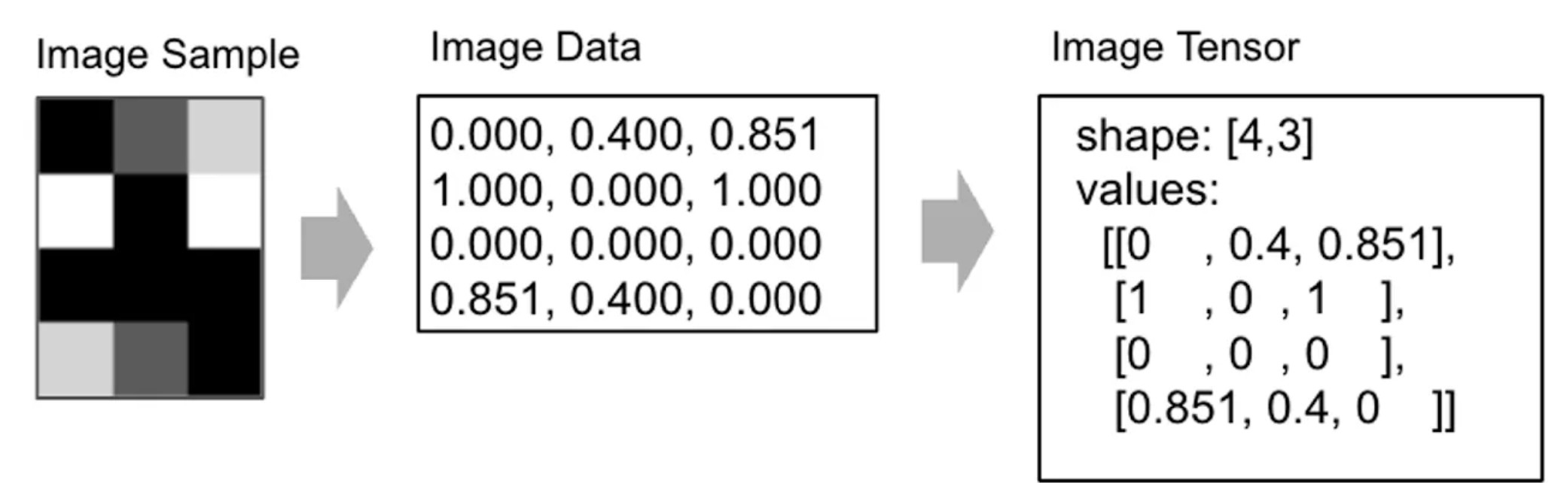
Image Data
https://muneebsa.medium.com/deep-learning-101-lesson-18-image-data-in-machine-vision-d2e07afa1c36

Slide 27
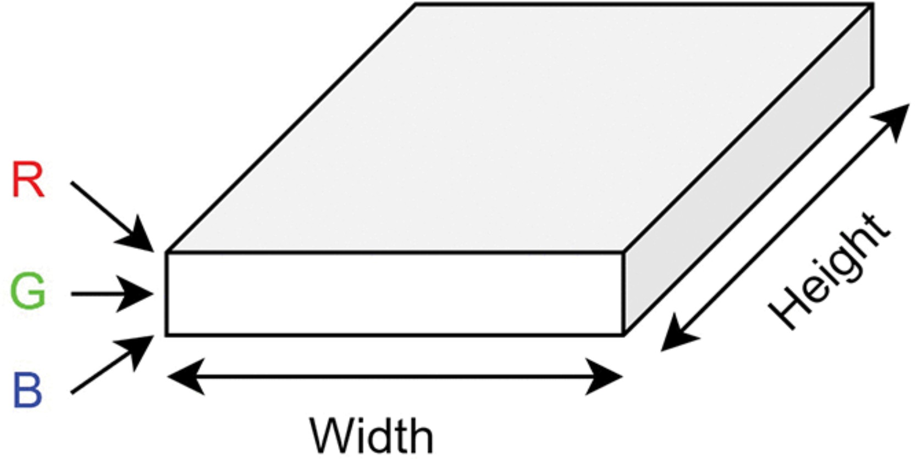
Image Data
Image can be represented as a cuboid with channels, height and width. For instance, a colored RGB image has 3 channels, while a grayscale image has just 1.
https://www.sciencedirect.com/org/science/article/pii/S152614922400050X

Slide 28

Image Data
When extending this concept to color images, the input data forms a tensor. For example, for a RGB format, each of R, G or B channels is represented as a separate matrix, and the combination of these matrices forms the tensor representing the image.
In a standard 8-bit per channel color image, each of the R, G, and B channels can have intensity values ranging from 0 to 255. This allows for 256 different intensities per channel, combining to produce a possible palette of over 16 million colors (256³ combinations).

Slide 29
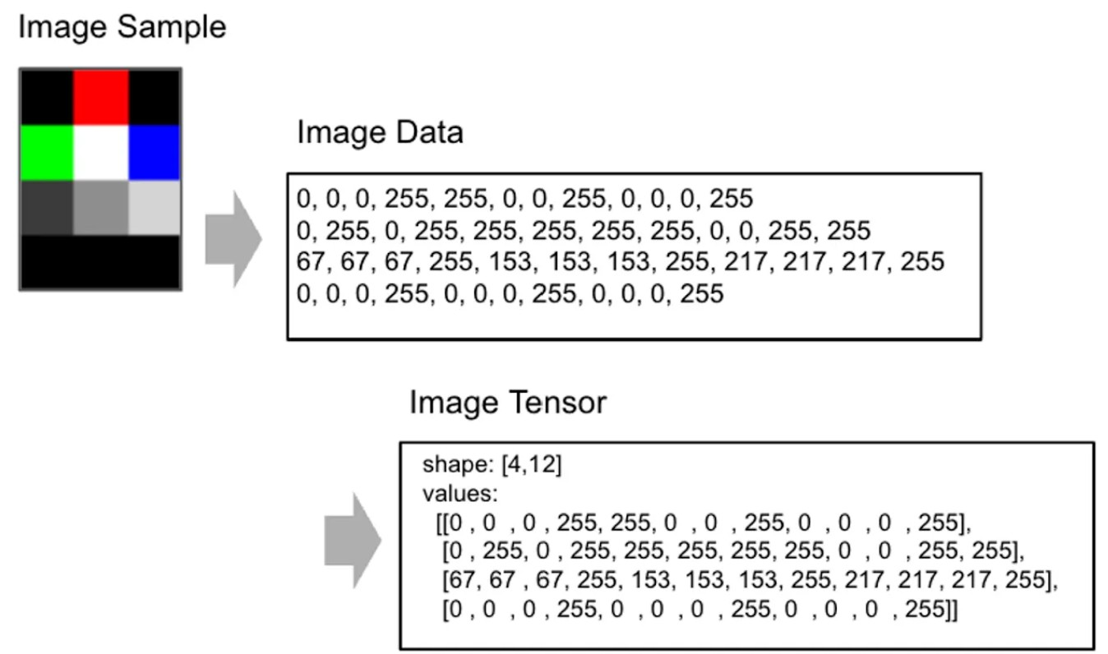
Image Data
Representation of color image data as an RGBA tensor, where A denotes the Alpha channel for transparency of the color: 0 represents a fully transparent color, and 255 represents a fully opaque color.
https://muneebsa.medium.com/deep-learning-101-lesson-18-image-data-in-machine-vision-d2e07afa1c36

Slide 30
Image Data. Image Processing
Image preprocessing techniques are indispensable steps in the preparation of data for machine learning training
Normalisation adjusts pixel values to a common scale, enhancing model convergence and learning efficiency.
Resizing is used to standardize the dimensions of all images in a dataset. Techniques like cropping, padding, or using aspect ratio preserving scaling are common
Augmentation is used to expand the diversity of a dataset by applying various transformations to the images. Examples: Rotation, Translation, Scaling, Flipping, Adding Noise, etc.
Feature Extraction is automatically retrieved using CNNs, where different kind of filters are applied to capture basic (edges, lines, and simple textures) and higher level features (complex and abstract representations of the image)

Slide 31
Image Data. Annotation
Image annotation is the process of labeling images to train supervised models.
Image annotations can be performed both manually and by using an automated annotation tool.
Simple image annotation may involve labeling an image with a phrase that describes the objects pictured in it. For example, you might annotate an image of a cat with the label “cat”.
Complex image annotation can be used to identify, count, or track multiple objects or areas in an image. For example, you might annotate the difference between breeds of cat.

Slide 32
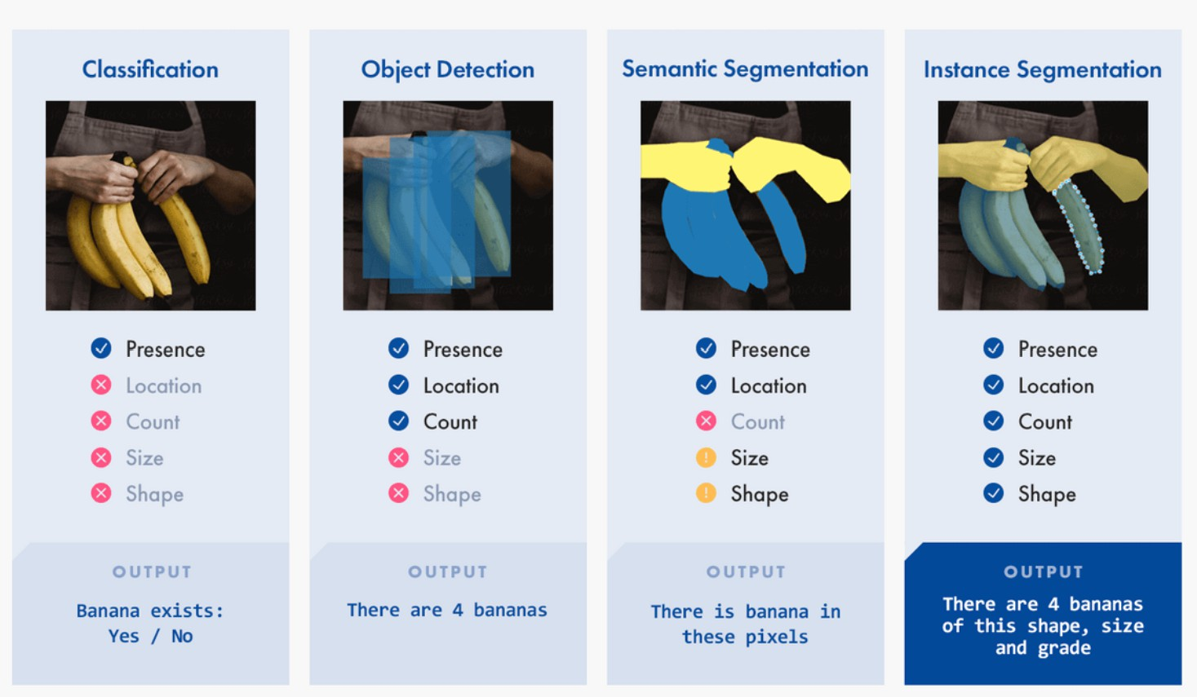
Image Data. Annotation
Types of annotation
https://www.cloudfactory.com/image-annotation-guide

Slide 33
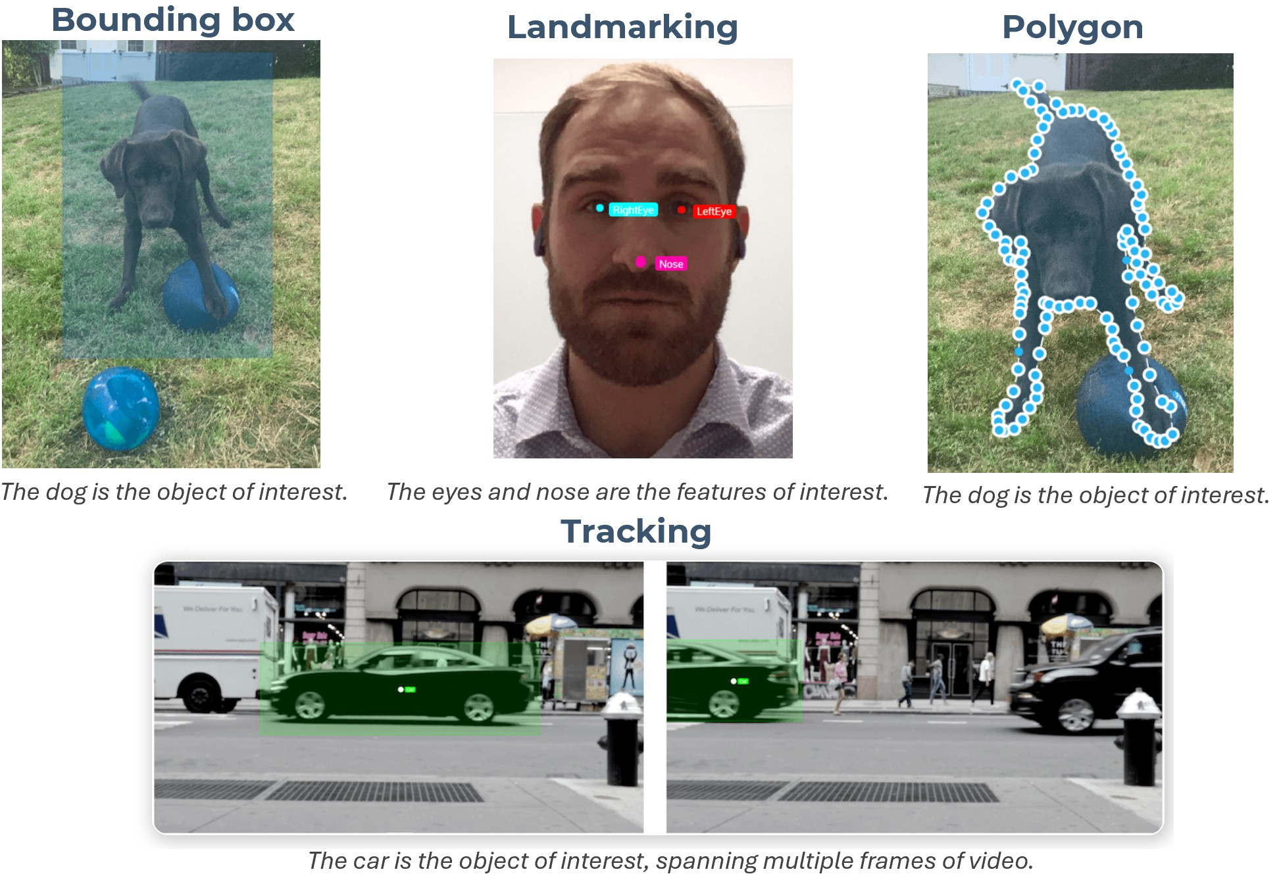
Image Data. Annotation
Image Annotation Techniques
https://www.cloudfactory.com/image-annotation-guide

Slide 34
Table of Contents
AI Taxonomy
Computer Vision Deep Learning
Deep Learning. Model Building Blocks Image Data
Artificial Neural Network Key Activation Functions Residual Connections Convolution
Many hidden layers

Slide 35
Artificial Neural Network
Artificial neural networks - a biologically-inspired programming paradigm which enables a computer to learn from observational data.
Both artificial and biological neurons operate on the same basic principle: they receive inputs from multiple sources, process them by performing a computation, and produce outputs that depend on the inputs—in the case of biological neurons, firing only when a certain threshold is exceeded.
However, while biological neurons are intricate physical structures with many components and interacting cells, artificial neurons are simplified computational units designed to mimic a few of their characteristics.

Slide 36
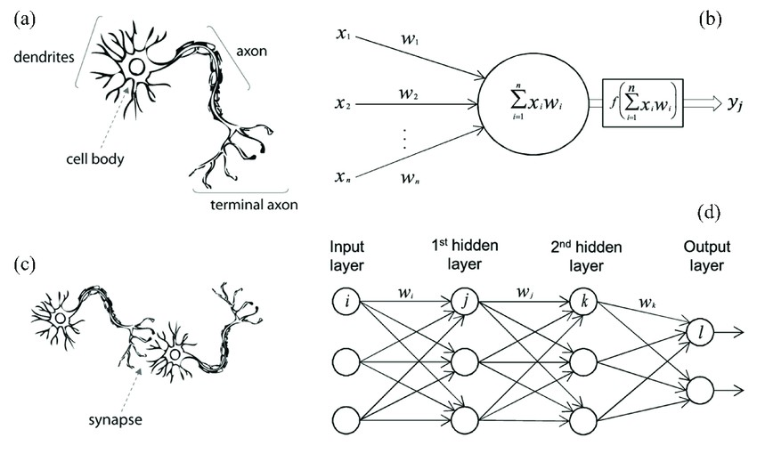
Artificial Neural Network vs. Biological Neural Network
Figure: (a) human neuron (b) artificial neuron (c) biological synapse (d) ANN synapses
Meng, Zhenzhu & Hu, Yating & Ancey, Christophe. (2020). Using a Data Driven Approach to Predict Waves Generated by Gravity Driven Mass Flows 10.3390/w12020600

Slide 37
Artificial Neural Network
Artificial Neural network is a type of machine learning algorithm composed of layers of interconnected nodes or neurons.
Neurons are the basic computational units of neural networks. All the neurons in a layer can be represented as a vector of activations.
In any ANN layer, this activation vector is multiplied with an input and then transformed by applying an element-wise nonlinear function to the result. This is the layer’s output, which becomes the input to the next layer.
The network as a whole is the composition of all of its layers.

Slide 38
Artificial Neural Network
In a regular Neural Network there are three types of layers:
Input Layers: It’s the layer in which we give input to our model. The number of neurons in this layer is equal to the total number of features in our data (number of pixels in the case of an image).
Hidden Layer: The input from the Input layer is then fed into the hidden layer. There can be many hidden layers depending on our model and data size. Each hidden layer can have different numbers of neurons which are generally greater than the number of features. The output from each layer is computed by matrix multiplication of the output of the previous layer with learnable weights of that layer and then by the addition of learnable biases followed by activation function which makes the network nonlinear.
Output Layer: The output from the hidden layer is then fed into a logistic function like sigmoid or softmax which converts the output of each class into the probability score of each class.

Slide 39
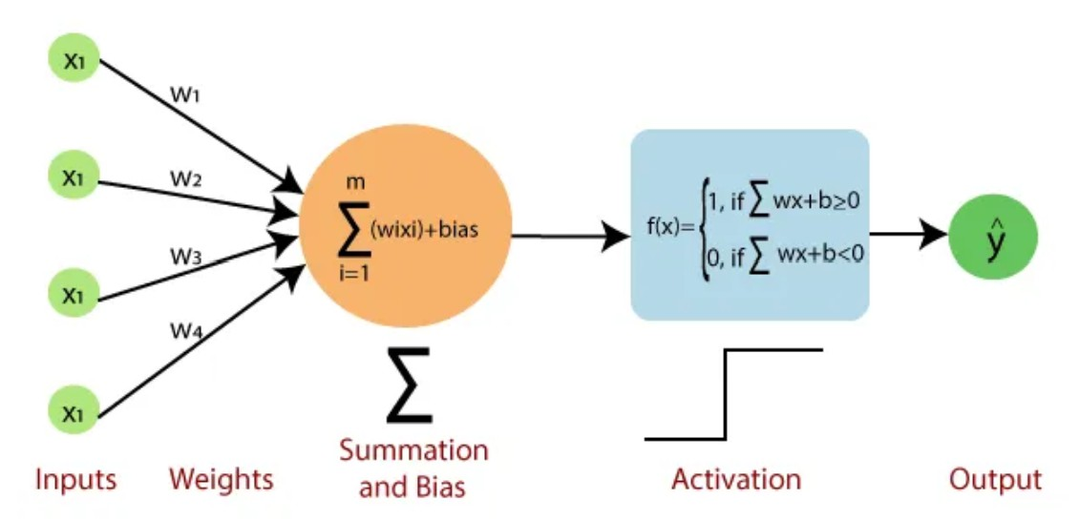
Artificial Neural Network. Their types 1/6
Single-layer perceptron (SLP): a simple artificial neural network architecture in which data moves from input to output in a single direction. It is a forward-propagation approach. Here, no hidden layers in between.
https://www.javatpoint.com/single-layer-perceptron-in-tensorflow

Slide 40
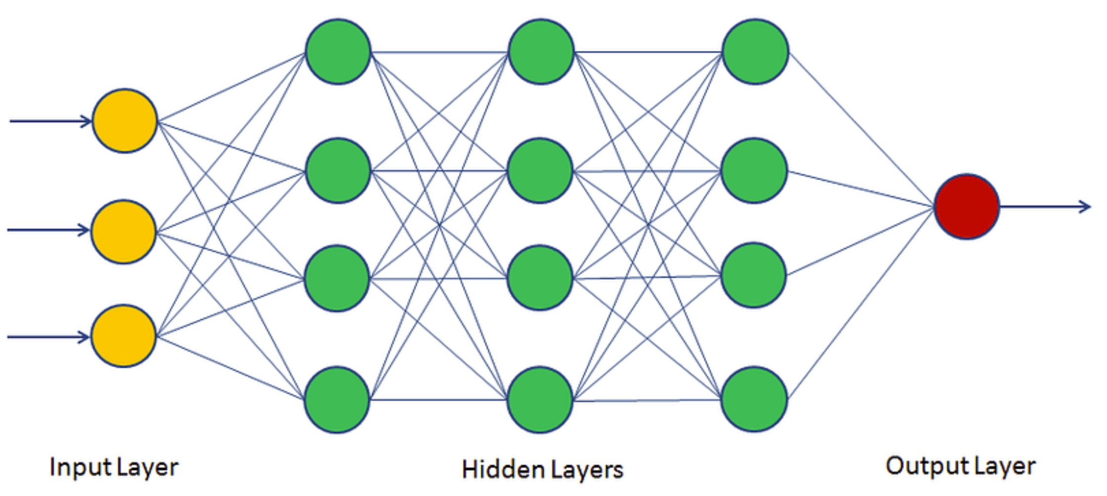
Artificial Neural Network. Their types 2/6
Multi-layer Perceptron (MLP): a type of neural network with three or more layers, including an input layer, one or more hidden layers, and an output layer.
Training involves adjusting the parameters, or the weights and biases, of the model to minimize error. It employs not only Forward Propagation, but also a Back-Propagation, e.g. Gradient Decent optimizer used to tune ANN
parameters by minimizing loss.
https://https://machinelearninggeek.com/multi-layer-perceptron-neural-network-using-python/
40 / 64

Slide 41
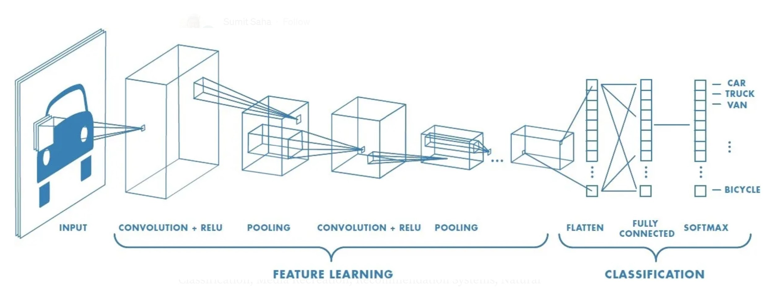
Artificial Neural Network. Their types 3/6
Convolutional Neural Network (CNN): a specialized ANN designed for image processing. It employs convolutional layers to automatically learn hierarchical features from input images. CNNs have revolutionized computer vision.
https://towardsdatascience.com/a-comprehensive-guide-to-convolutional-neural-networks-the-eli5-way-3bd2b1164a53

Slide 42
Artificial Neural Network. Their types 4/6
Long Short-Term Memory (LSTM) and Recurrent Neural Networks (RNNs) are both types of neural networks used for sequence modeling, especially when handling time series data, text, or other types of sequential input.
Feature | RNN | LSTM
Memory Ability | Short-term dependencies | Long-term dependencies
Architecture | Simple | Complex with memory cells
 |  | and gates
Training Efficiency | Faster | Slower, higher computational
 |  | cost
Best Use Cases | Short-sequence tasks | Long-sequence tasks, com-
 |  | plex dependencies
Vulnerability | Vanishing Gradient Problem | Resilient to vanishing gradi-
 |  | ents

Slide 43
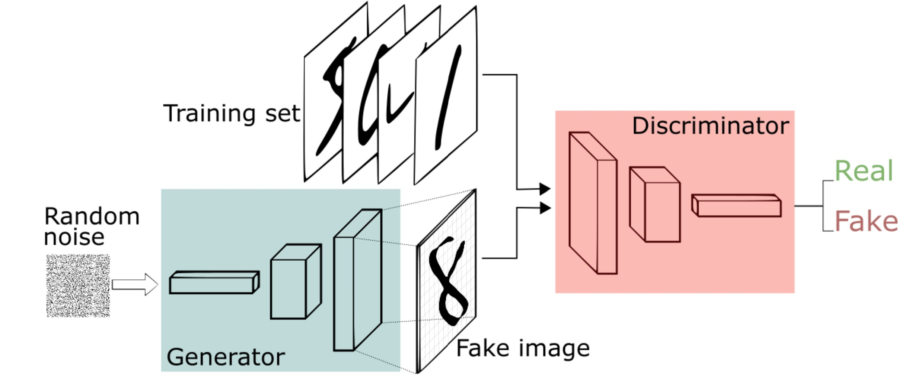
Artificial Neural Network. Their types 5/6
Generative Adversarial Networks (GAN): the generator tries to create fake data, and the discriminator attempts to distinguish between real and fake data.
https://sthalles.github.io/intro-to-gans/

Slide 44
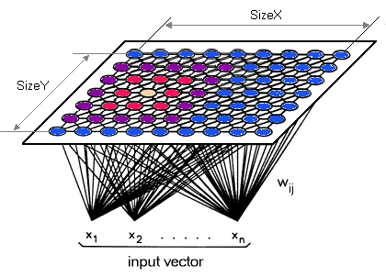
Artificial Neural Network. Their types 6/6
Self-Organizing Maps (SOM): neural network that organizes data into a map to represent high-dimensional data in a low-dimensional space.
Autoencoders: neural network used primarily for unsupervised learning.
They are designed to learn efficient, compressed representations of input data, for tasks like dimensionality reduction, denoising, or anomaly detection
https://sites.pitt.edu/~is2470pb/Spring05/FinalProjects/Group1a/tutorial/

Slide 45
Table of Contents
AI Taxonomy
Computer Vision Deep Learning
Deep Learning. Model Building Blocks Image Data
Artificial Neural Network Key Activation Functions Residual Connections Convolution
Many hidden layers

Slide 46
Key Activation Functions
Activation functions are a vital component of neural networks. Their role - to get the output of node.
By defining the activations of each neuron within the network, activation functions act as informational gatekeepers that control data transfer from one layer of the network to the next.
There are many activation functions, each with unique properties and applications. The selection and placement of activation functions can significantly change the network’s capability and performance.
Different layers may use other activation functions.
Sigmoid, Softmax, ReLU, tanh are among the most popular ones.

Slide 47
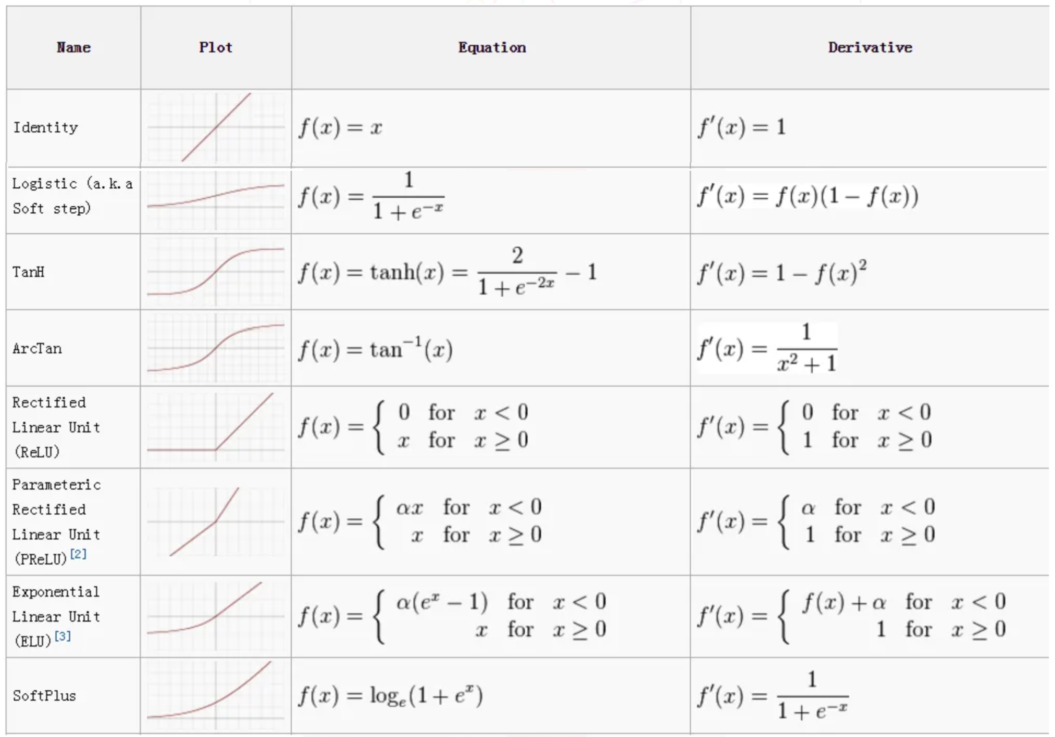
Key Activation Functions. Examples
https://towardsdatascience.com/activation-functions-neural-networks-1cbd9f8d91d6

Slide 48
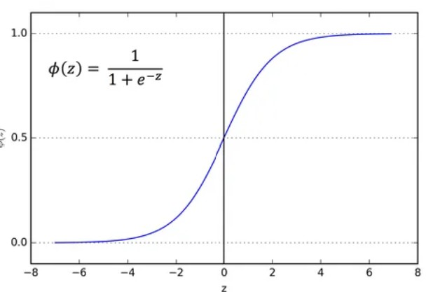
Key Activation Functions. Sigmoid or Logistic Function
Sigmoid function is used for a binary classification. Since it maps the input to a range between 0 and 1, it can represent probabilities for binary outcomes. Also, it is used as an activation function in hidden layers, but not in deep architectures due to vanishing gradients during backpropagation.
https://towardsdatascience.com/activation-functions-neural-networks-1cbd9f8d91d6

Slide 49
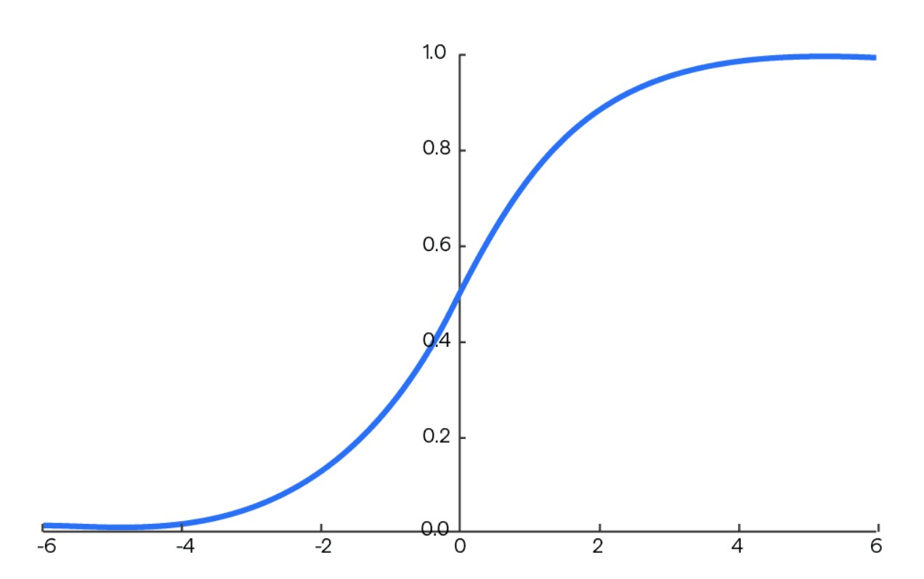
Key Activation Functions. Softmax function
The softmax function s(x ) is a more generalized logistic activation
function which is used for multiclass classification, typically in the output layer. Unlike other activation functions that operate on each input individually, softmax considers all inputs simultaneously to create a probability distribution across
many dimensions.
https://towardsdatascience.com/activation-functions-neural-networks-1cbd9f8d91d6

Slide 50
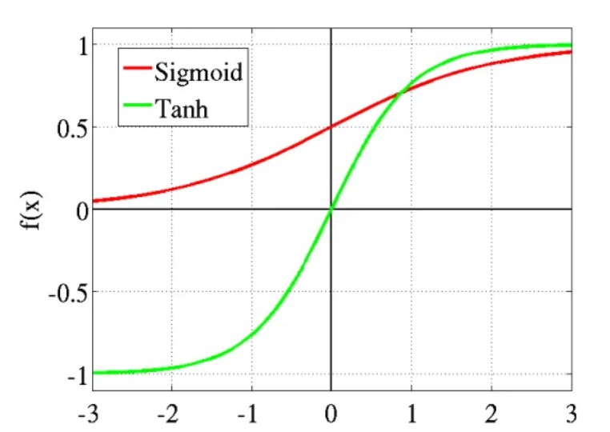
Key Activation Functions. Tanh or hyperbolic tangent function
The range of the tanh function is from (-1 to 1). It is commonly used as an activation function in hidden layers of deep learning models because of its zero-centered output, which tends to help networks converge faster and more effectively compared to sigmoid in some applications.
https://towardsdatascience.com/activation-functions-neural-networks-1cbd9f8d91d6
50 / 64

Slide 51
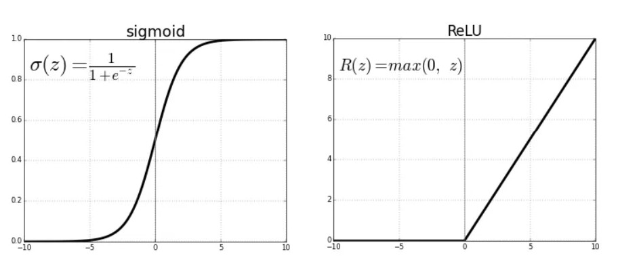
Key Activation Functions. ReLU (Rectified Linear Unit)
The ReLU is the most used activation function in the world right now, particularly in deep learning due to its simplicity, speed, ability to reduce vanishing gradient problems, and efficiency in sparse activations, making it an optimal choice for most hidden layers in convolutional and deep neural networks. By setting all negative values to zero, ReLU effectively makes networks sparse (most neurons don’t activate simultaneously): promotes efficient computation and reduces interdependencies, making networks less prone to overfitting.
https://towardsdatascience.com/activation-functions-neural-networks-1cbd9f8d91d6

Slide 52
Table of Contents
AI Taxonomy
Computer Vision Deep Learning
Deep Learning. Model Building Blocks Image Data
Artificial Neural Network Key Activation Functions Residual Connections Convolution
Many hidden layers

Slide 53
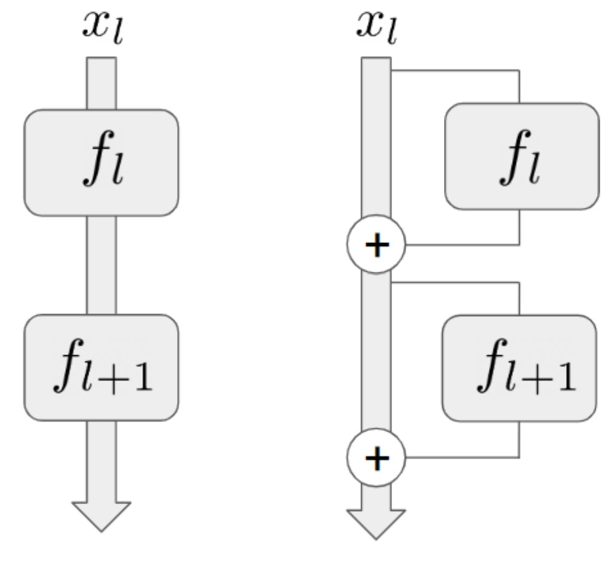
Residual Connections
Residual connections, or skip connections, introduce alternative pathways within a network, allowing information to bypass specific layers or blocks. Without these connections, data must pass through each layer sequentially.
Residual connections help retain the original data characteristics, ensuring that layers have access to more than just the immediate previous layer’s output. This enables lower-level features captured in earlier layers to contribute more directly to higher-level features in deeper layers.
https://www.aisafetybook.com/textbook/deep-learning

Slide 54
Table of Contents
AI Taxonomy
Computer Vision Deep Learning
Deep Learning. Model Building Blocks Image Data
Artificial Neural Network Key Activation Functions Residual Connections Convolution
Many hidden layers

Slide 55
Convolution
Convolution is a technique for identifying patterns or features within input data.
It applies a set of learnable filters known as the kernels to the input images.
The filters/kernels are smaller matrices usually 2×2, 3×3, or 5×5 shape.
Each filter is being slid across the whole input volume step by step where each step is called stride (it can a value of 1, 2, 3, or even 4 for
high-dimensional images).
The dot product between the kernel weights and patch is computed.
Padding refers to the process of adding extra pixels around the edges of an input image.
The output of this layer is referred as feature maps. It has a depth equal to the number of filters is obtained.

Slide 56
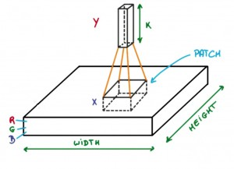
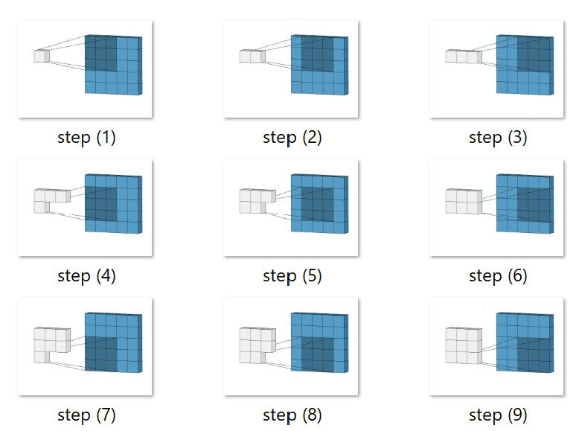
Convolution
This process slides the filter across the input data, systematically evaluating segments by performing matrix multiplication with the filter, and storing the resulting values in a new matrix called the feature map.
https://www.geeksforgeeks.org/introduction-convolution-neural-network/ https://towardsdatascience.com/convolutional-neural-networks-explained-9cc5188c4939

Slide 57
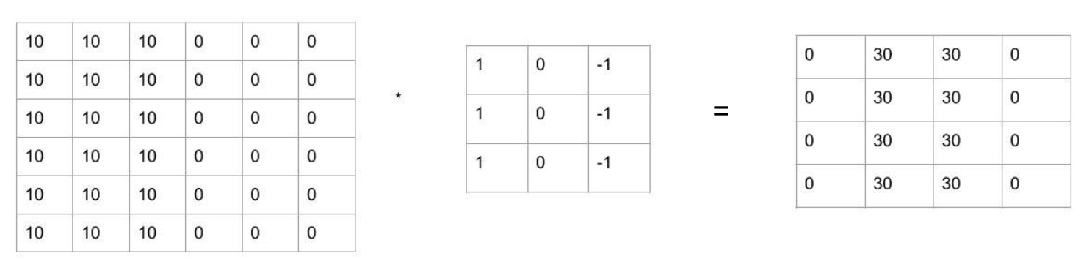
Convolution
Element wise multiplication

Slide 58
Table of Contents
AI Taxonomy
Computer Vision Deep Learning
Deep Learning. Model Building Blocks Image Data
Artificial Neural Network Key Activation Functions Residual Connections Convolution
Many hidden layers

Slide 59
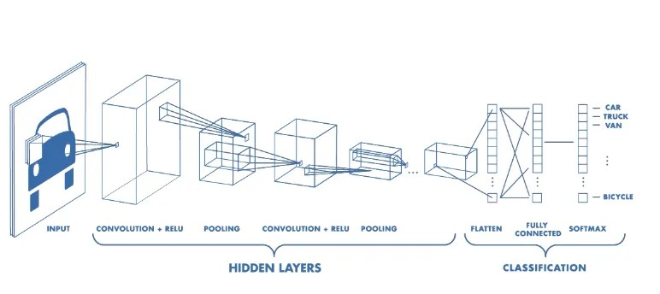
Many hidden layers
CNN typically includes: a convolutional layer, a pooling layer, and a fully connected layer
https://towardsdatascience.com/convolutional-neural-networks-explained-9cc5188c4939

Slide 60
Many hidden layers. Pooling layer
This layer is periodically inserted in CNNs and its main function is to reduce the size of volume which makes the computation fast reduces memory and also prevents overfitting.
Two common types of pooling layers are max pooling and average pooling.
Reducing the number of neurons makes it less computationally intensive. This is particularly beneficial for handling large images or complex architectures.
Pooling helps retain essential information by selecting dominant features.

Slide 61
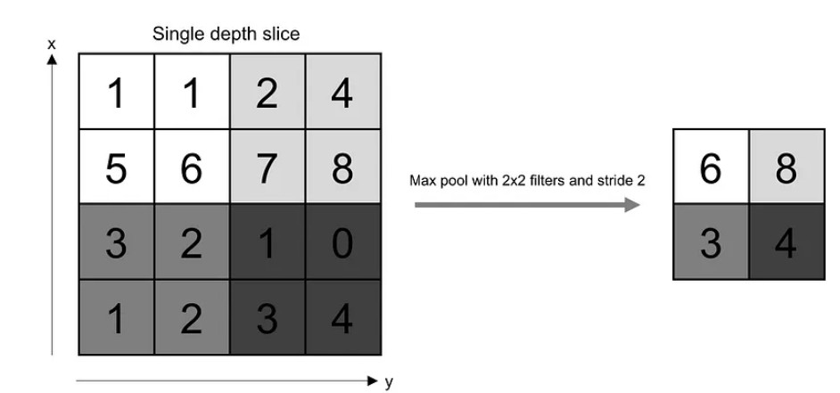
Many hidden layers. Pooling layer
Max pooling, for example, captures the most prominent feature (the maximum value) in each region, while average pooling captures the average value, summarizing information within regions.
Examples of other pooling functions: L2 norm of the rectangular neighborhood; a weighted average based on the distance from the central pixel.
https://towardsdatascience.com/convolutional-neural-networks-explained-9cc5188c4939

Slide 62
Many hidden layers. Fully Connected (FC) Layers
After convolution and pooling layers have reduced the input image to a smaller, feature-rich representation, FC layers interpret these features to make a prediction.
Each neuron in an FC layer is connected to all neurons in the previous layer, enabling the network to learn complex combinations of features.
FC layers allow the CNN to perform high-level reasoning by weighing and combining the abstracted features, helping distinguish between classes or predict outputs based on complex patterns.
In classification tasks, the final FC layer typically has one neuron per class. Each neuron’s output represents the network’s confidence level in the image belonging to a specific class, especially when combined with a softmax activation for multi-class classification.

Slide 63
References
▶ https://www.geeksforgeeks.org/introduction-convolution-neural-network/
▶ https://www.aisafetybook.com/textbook/deep-learning/
▶ https://www.geeksforgeeks.org/deep-learning-tutorial/
▶ http://neuralnetworksanddeeplearning.com/
▶ https://www.saedsayad.com/artificial_neural_network_bkp.htm
▶ https://muneebsa.medium.com/deep-learning-101-lesson-18-image-data-in-machine-vision-d2e07afa1c36
▶ https://www.v7labs.com/blog/image-annotation-guide
▶ https://www.cloudfactory.com/image-annotation-guide
▶ https://www.v7labs.com/blog/cross-entropy-loss-guide
▶ https://www.v7labs.com/blog/confusion-matrix-guide
▶ https://www.geeksforgeeks.org/convolutional-neural-network-cnn-architectures/
▶ https://towardsdatascience.com/convolutional-neural-networks-explained-9cc5188c4939

Slide 64
Neural Networks.
Deep Learning
Kristina Sutiene and Liepa Bikulciene
Kaunas University of Technology Athens, Greece
Nov 18-22, 2024

